Slide 1
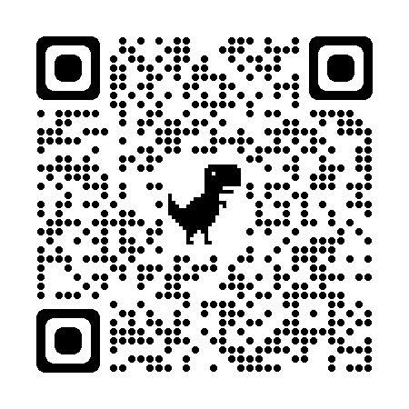
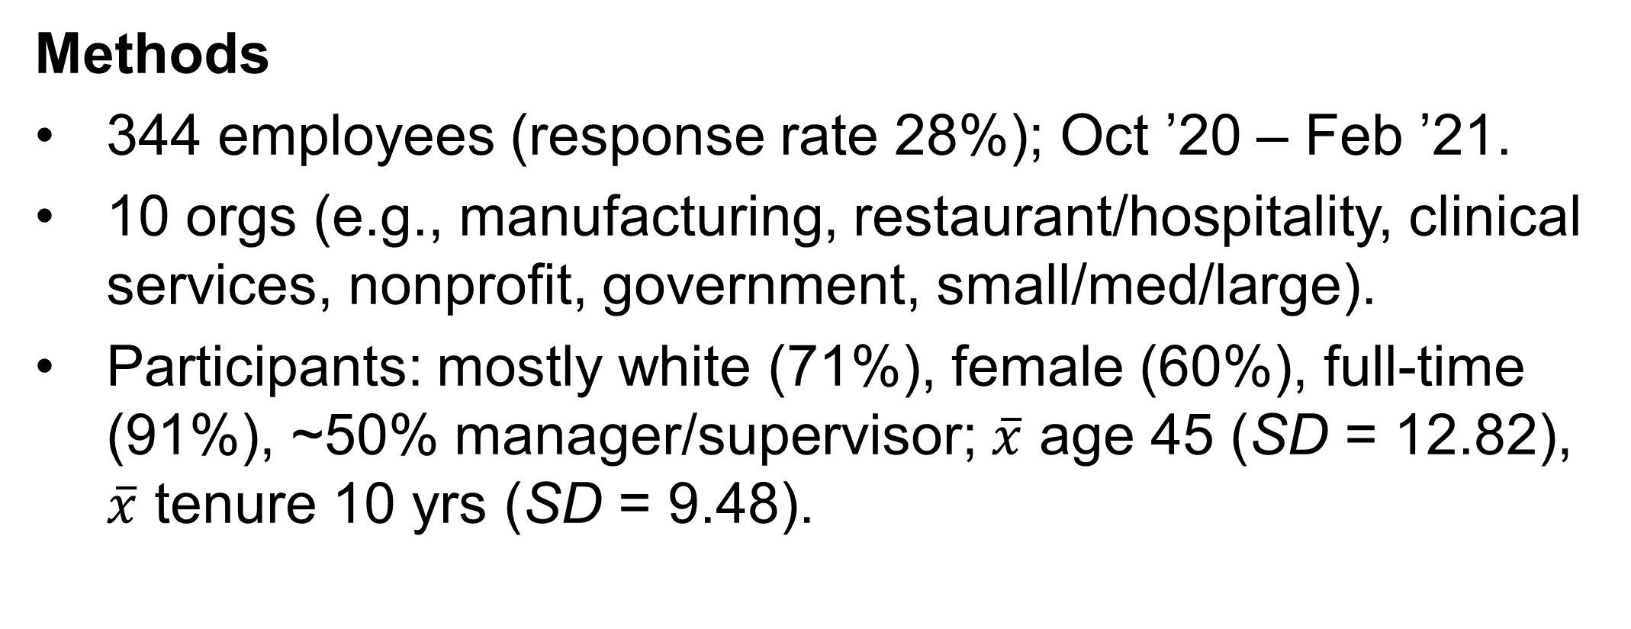
Organizations that used psychologically healthy workplace practices during COVID saw higher employee well-being and positive organizational outcomes.
Employee involvement, recognition, and growth & development were all important predictors.
Psychologically Healthy Workplaces, Wellbeing, & Performance During COVID
Dr. Courtney Keim, Bellarmine University
Organizations that offered more employee recognition programs had higher employee wellbeing.
Emp Wellbeing
Employee Recognition
Work-life balance
Health & Safety
Employee Involvement
Employee Growth & Development
Intro
COVID caused massive organizational change and uncertainty in workplaces.
Psychologically healthy workplace (PHW) programs give specific ways to address major org change.
β = .28
β = .37
β = .01
Employee Wellbeing
β = 1.08**
β = -.04
PHW practices
- Worklife Balance
- Emp Growth & Dev
- Health & Safety
- Emp Recognition
- Emp Involvement
H₁ +
H₃ +
H₄ +
Multiple Regression: F(5, 322) = 23.598, p < .001, R²=.268 | ** p < .001
H₂ +
Organizational Improvements
Employees who increased their use of growth & development and employee involvement programs had higher wellbeing.
PATH model (Grawitch et al., 2006)
Emp Wellbeing
Employee Growth & Development
Employee Recognition
Health & Safety
Work-life Balance
Employee Involvement
Methods
344 employees (response rate 28%); Oct ’20 – Feb ’21.
10 orgs (e.g., manufacturing, restaurant/hospitality, clinical services, nonprofit, government, small/med/large).
Participants: mostly white (71%), female (60%), full-time (91%), ~50% manager/supervisor; $\overline{x}$ age 45 (SD = 12.82), $\overline{x}$ tenure 10 yrs (SD = 9.48).
β = .34*
β = .48**
β = .15
β = .53**
β = .01
Measures
Org’s offering of PHW: “My employer promotes and supports employee health, safety, and well-being.”
Employees use of PHW: Increase in “Using flexible work arrangements (for example, telecommuting, flextime).”
Employee wellbeing: Work stress, motivation, job satisfaction, work-life conflict
Org outcomes: Job performance & turnover intention
Multiple Regression: F(5, 251) = 17.122, p < .001, R²=.254 | ** p < .01 * p < .05
Employees use of growth & development, involvement, and recognition programs linked to better org outcomes.
Org Outcomes
Employee Growth & Development
Health & Safety
Work-life Balance
Employee Recognition
Employee Involvement
Results
H1 and H2 supported. Direct effects of offering and use of PHW predicted outcomes (scan QR code for tables).
H3 and H4 supported. Indirect effects of offering and use thru each outcome was supported (scan QR code for tables).
Emp involvement, recognition, and growth & development predicted wellbeing and performance (see figures to right).
Take a picture to
download the full paper
β = .51**
β = .58**
β = -.17
β = .87**
β = -.12
Multiple Regression: F(5, 251) = 23.394, p < .001, R²=.318 | **p < .01

Slide 2




