Slide 1
Bellarmine University
School of Communication
2014 Senior Internship Recognition

Slide 2
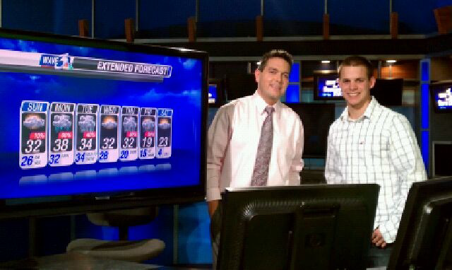

Sid Abramson
Sports and Weather Intern
WAVE 3 Studios
Weather and Marketing Intern
WAVE 3 Studios

Slide 3
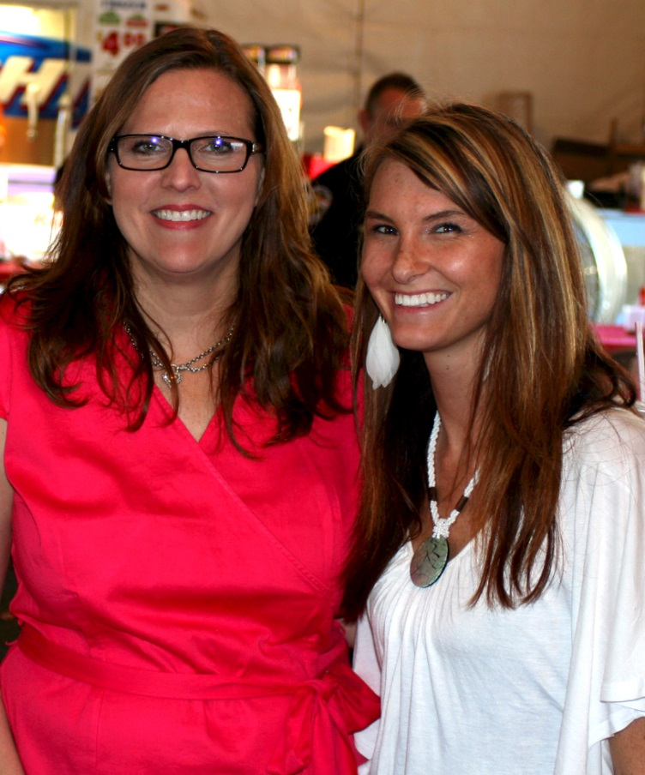
Andrea Ash
Next Generation Broadcasting Intern
84 WHAS & Clear Channel Radio
Membership Development & Marketing
    Main Street Association

Slide 4
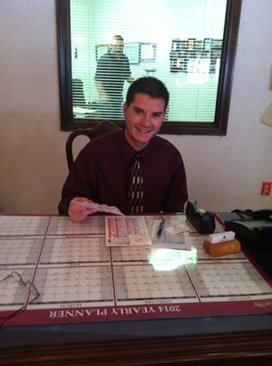
Steven Beckman
Marketing Intern
Cedar Court Assisted Living

Slide 5
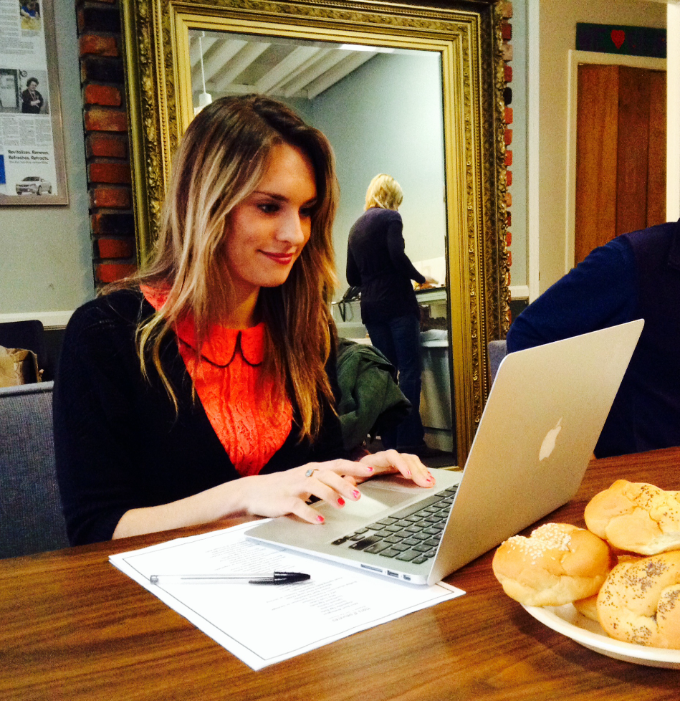
Emily Bertrand
Public Relations Intern
Dreams with Wings

Slide 6
Lauren Bradley
Public Relations Intern
Estes Public Relations

Slide 7
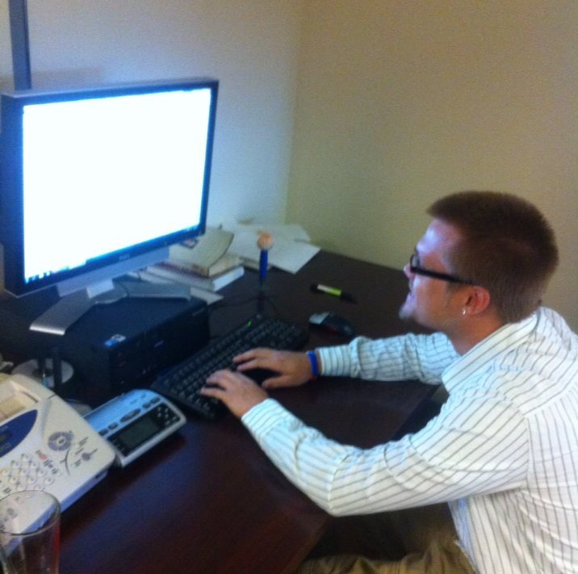
Dakota Branham
Media Relations Intern
BU Communication & Public Affairs

Slide 8
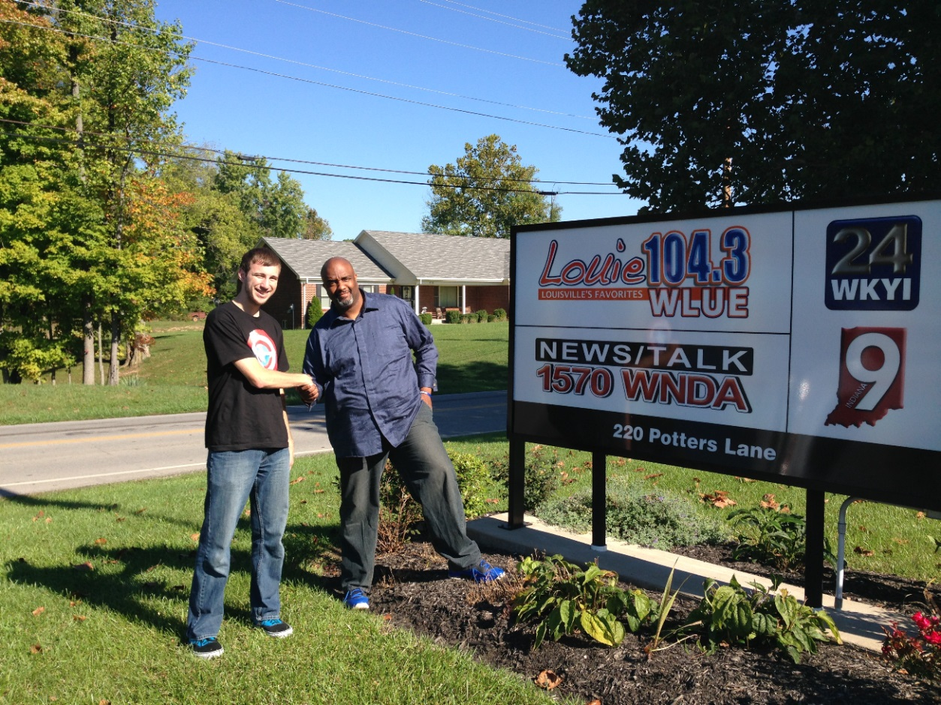
Alex Breen
Social Media Coordinator
Noiz Media Entertainment

Slide 9
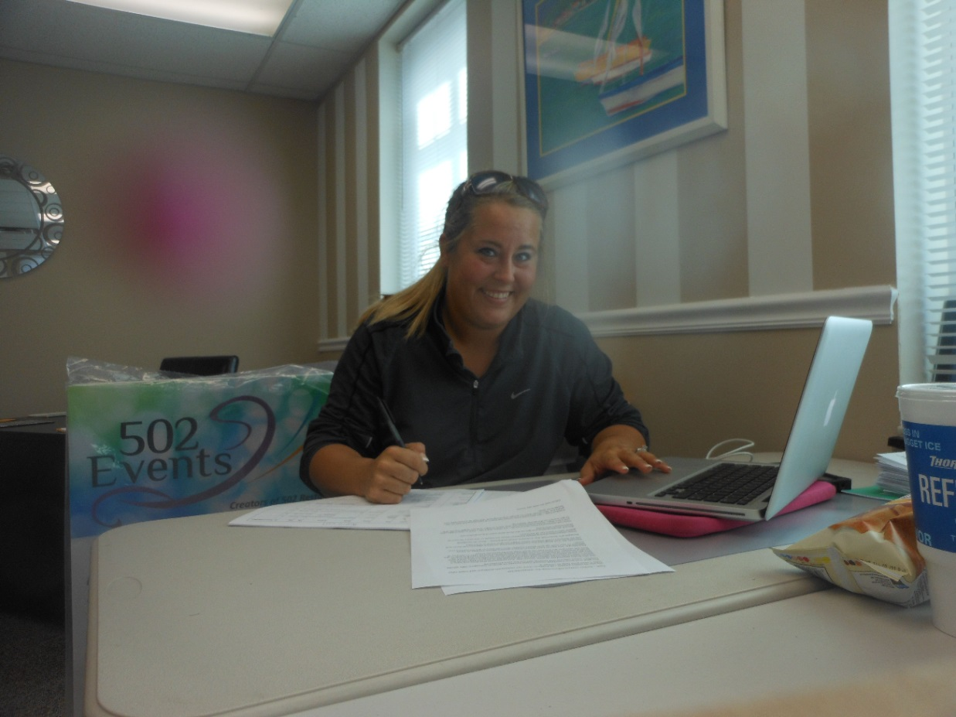
Sarah Brown
Communication Intern
502 Events

Slide 10
Katie Burke
Social Media Intern
Kentucky Humane Society
Communication Intern
    AT&T Morning Line

Slide 11
Stephanie Chalko
Communication Intern
UofL Club Ice Hockey

Slide 12

Vincent Clark
Social Media Intern
People Strategy Consulting
Communication Intern
Summit Media

Slide 13
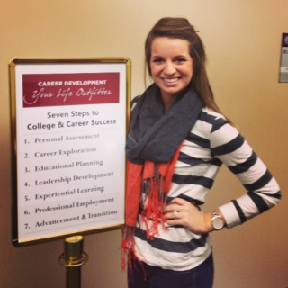
Tatum Daugherty
Marketing Coordinator Intern
Graceship
Special Events Assistant
  Muhammad Ali Center
Career Development Intern
Bellarmine Career Development Center

Slide 14
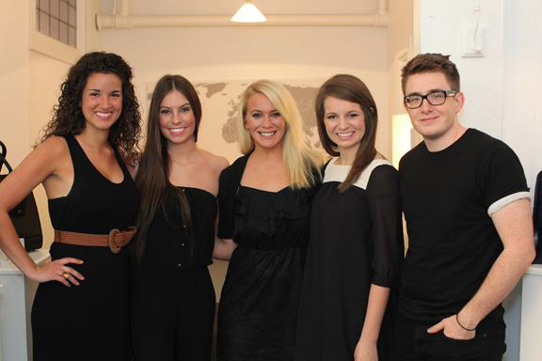
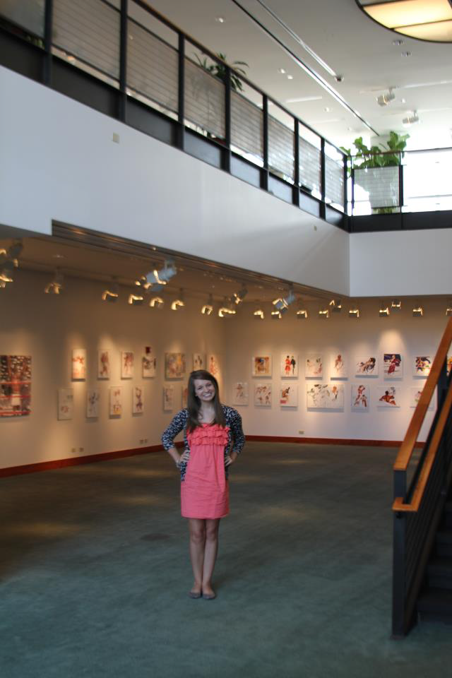
Tatum Daugherty

Slide 15
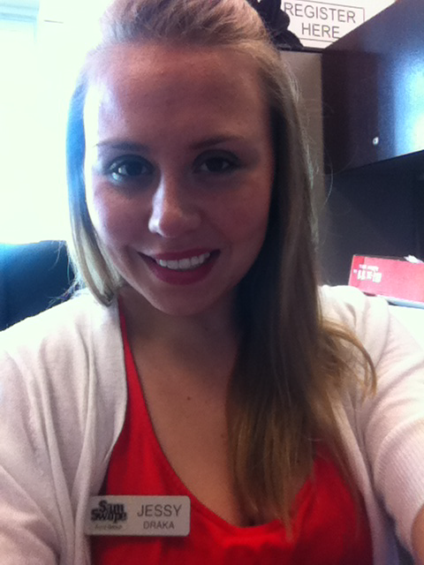
Jessy Draka
Communication Intern
Kentucky Derby Festival
Social Media Intern
Sam Swope Auto Group
Communication Intern
Kindred Healthcare

Slide 16
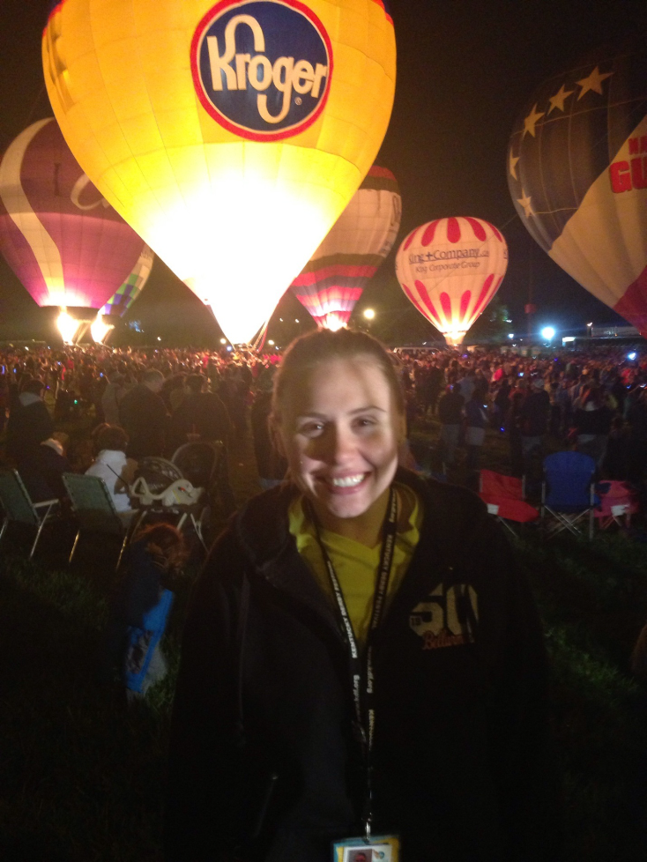
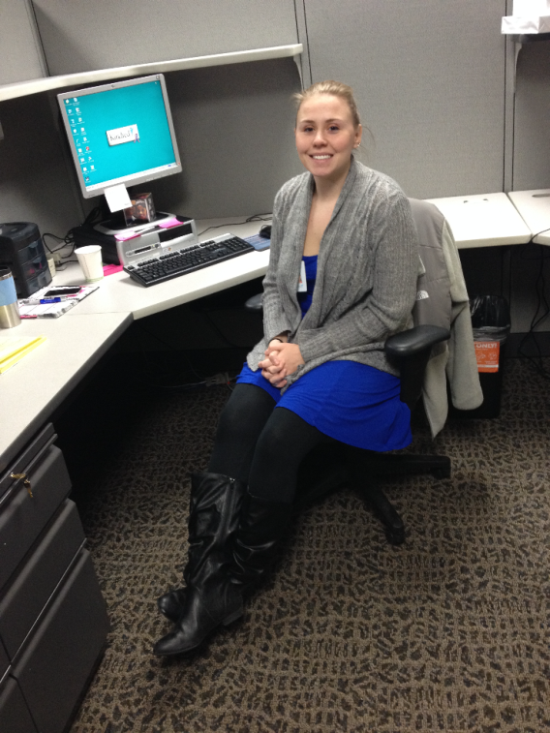
Jessy Draka

Slide 17
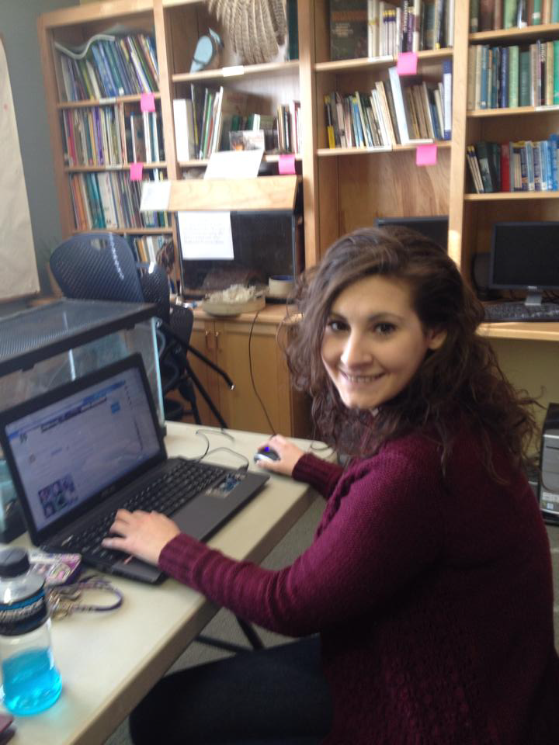
Jessica Dunne
Marketing Communication Intern
Louisville Nature Center

Slide 18
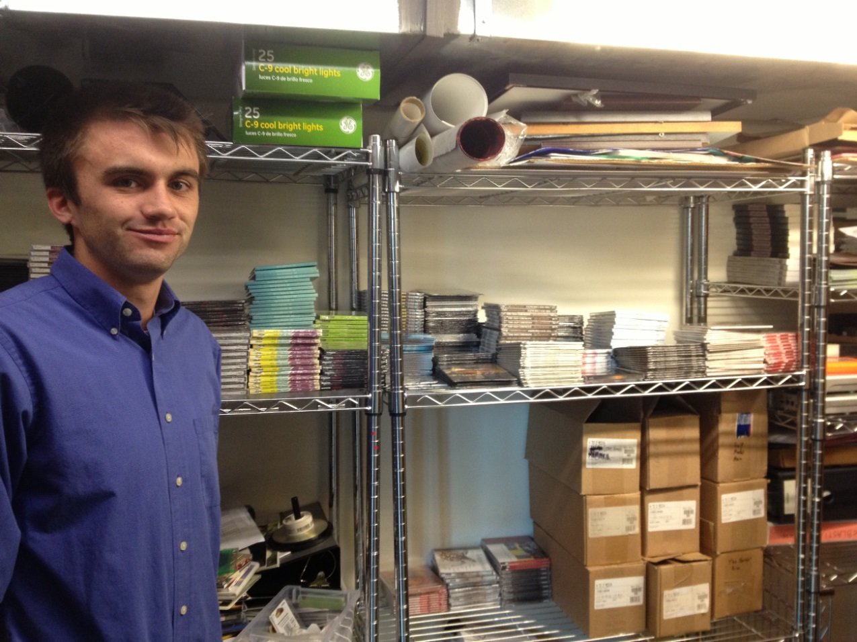
Will Ford
Communication Intern
sonaBlast! Records

Slide 19
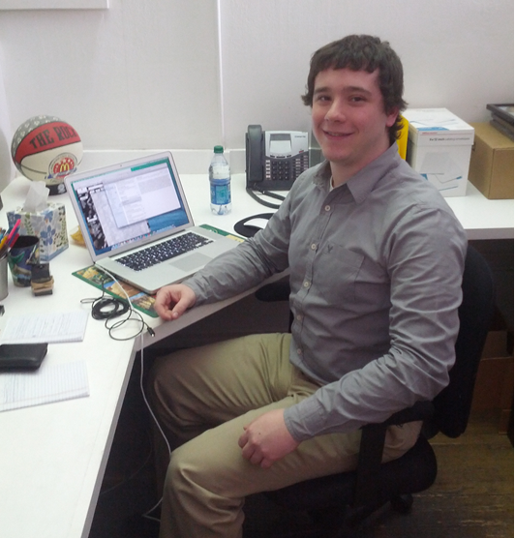
Dugan Gallina
Public Relations Intern
Bandy Carroll Hellige

Slide 20
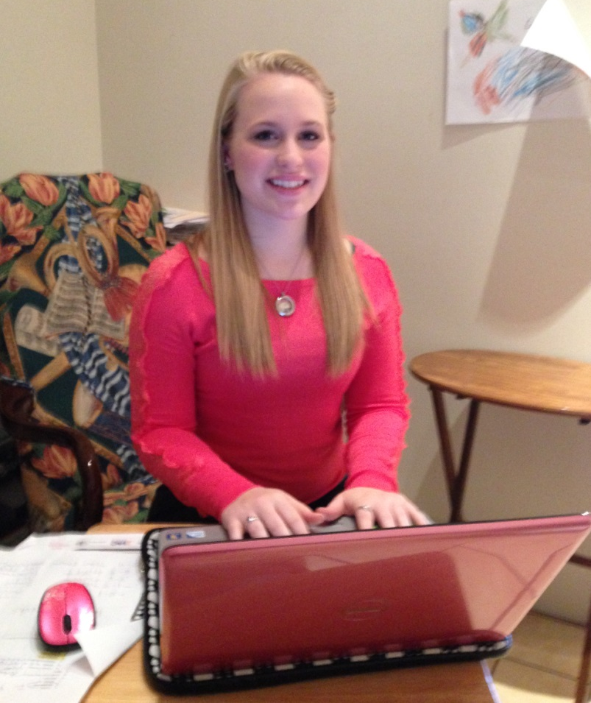
Amanda Goebel
Public Relations/Social Media Intern
Arts Council of Southern Indiana

Slide 21
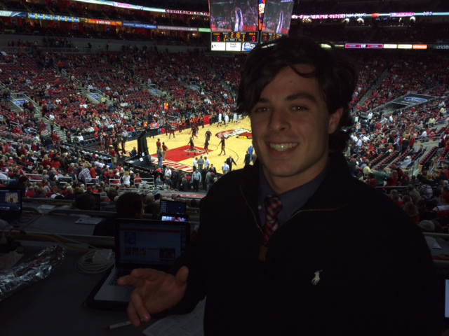
Corey Goodlett
Sports Journalist Intern
Cardinal Authority

Slide 22
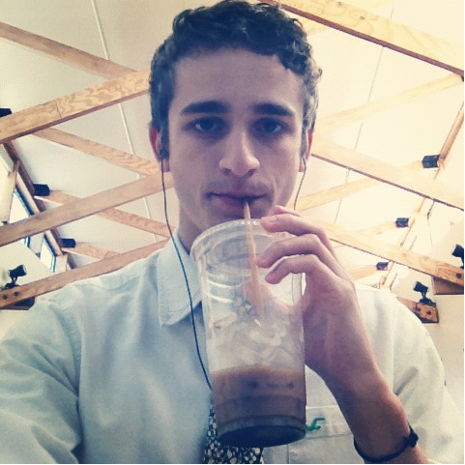
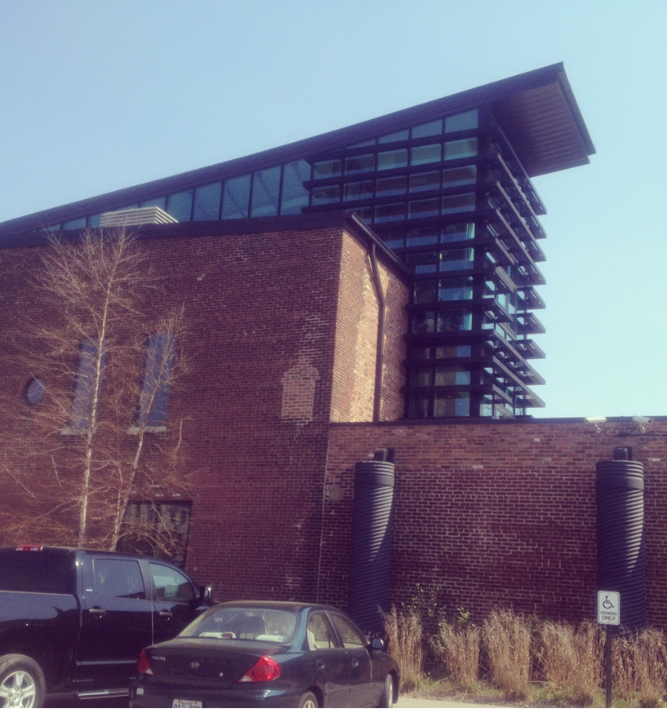
Joe Humphrey
Communication Intern
sonaBLAST! Records
Communication Intern
Market8Media

Slide 23
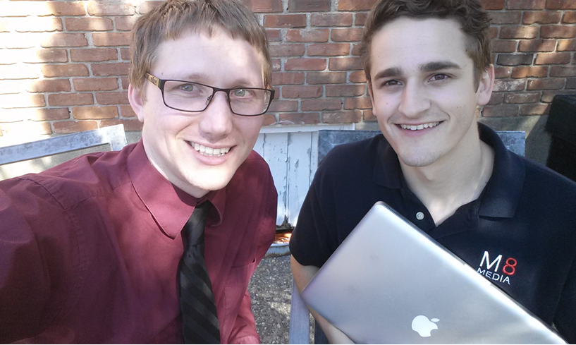
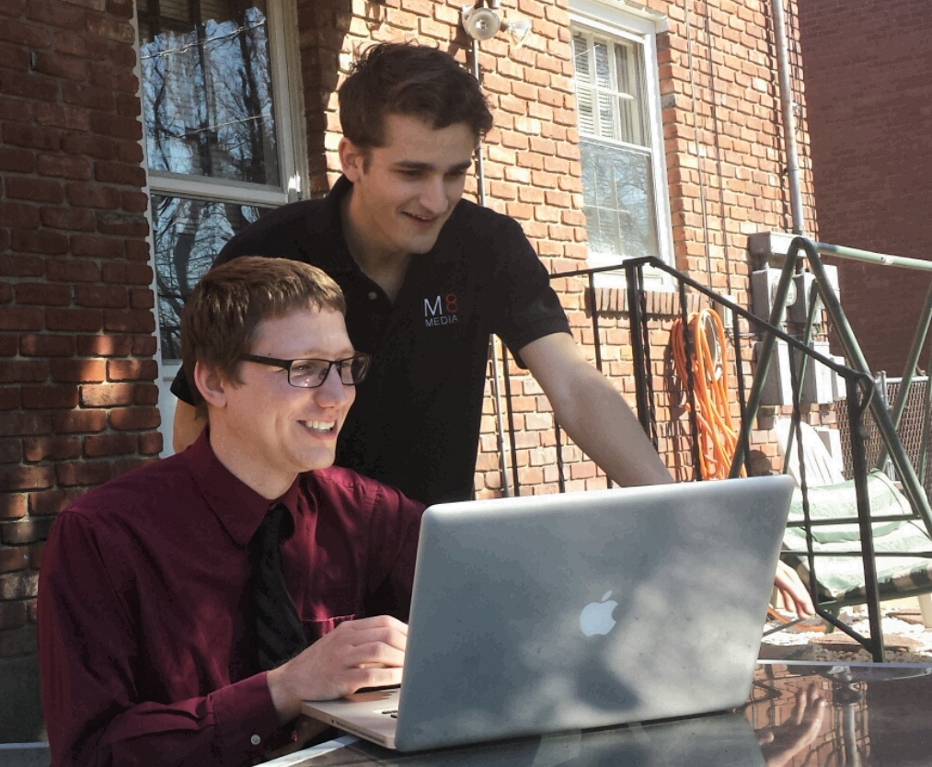
Joe Humphrey

Slide 24
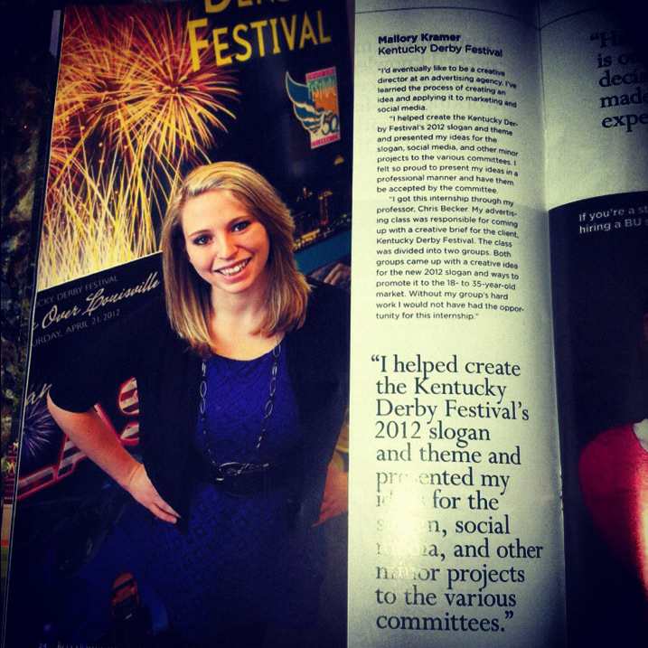
Mallory Kramer
Social Media Intern
Kentucky Derby Festival
Marketing and Communication Intern
Kentucky Telco Federal
Credit Union

Slide 25
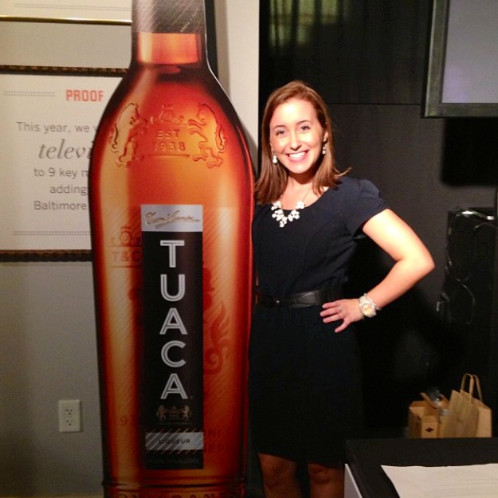
Marissa Leese
Communication Intern
Community Foundation of Louisville
Communication Intern
Brown-Forman Corp.

Slide 26
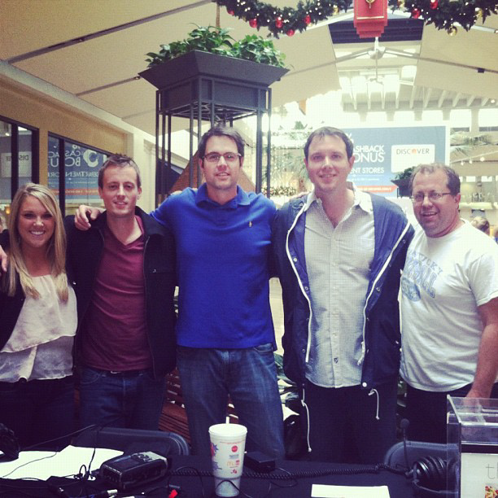
Taber Lewis
Sports Intern
WAVE 3 Studios
Intern
Kentucky Sports
Radio

Slide 27
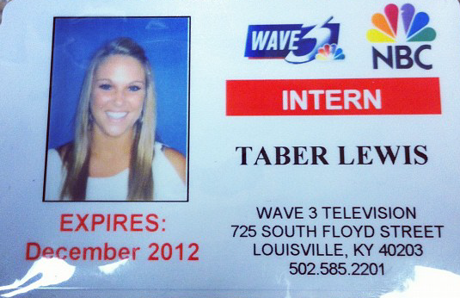
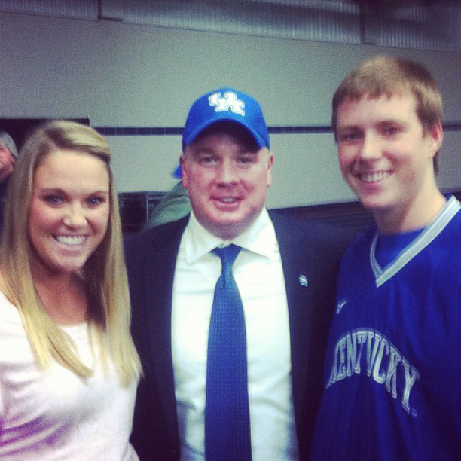
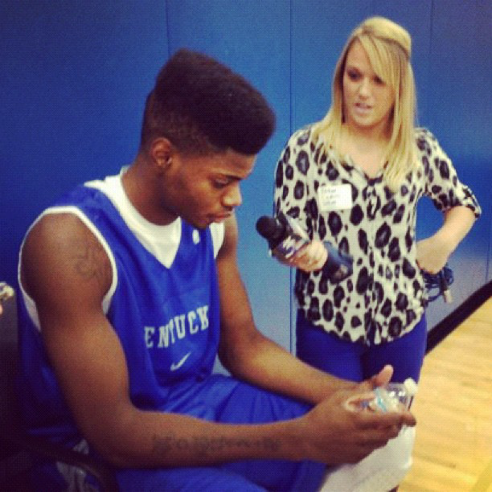

Taber Lewis

Slide 28
Zach Lindsey
Public Relations Intern
Brown-Forman Corporation
Public Relations Intern
Yum! Brands

Slide 29

Ellie Mann
News Intern
WLKY-TV

Slide 30
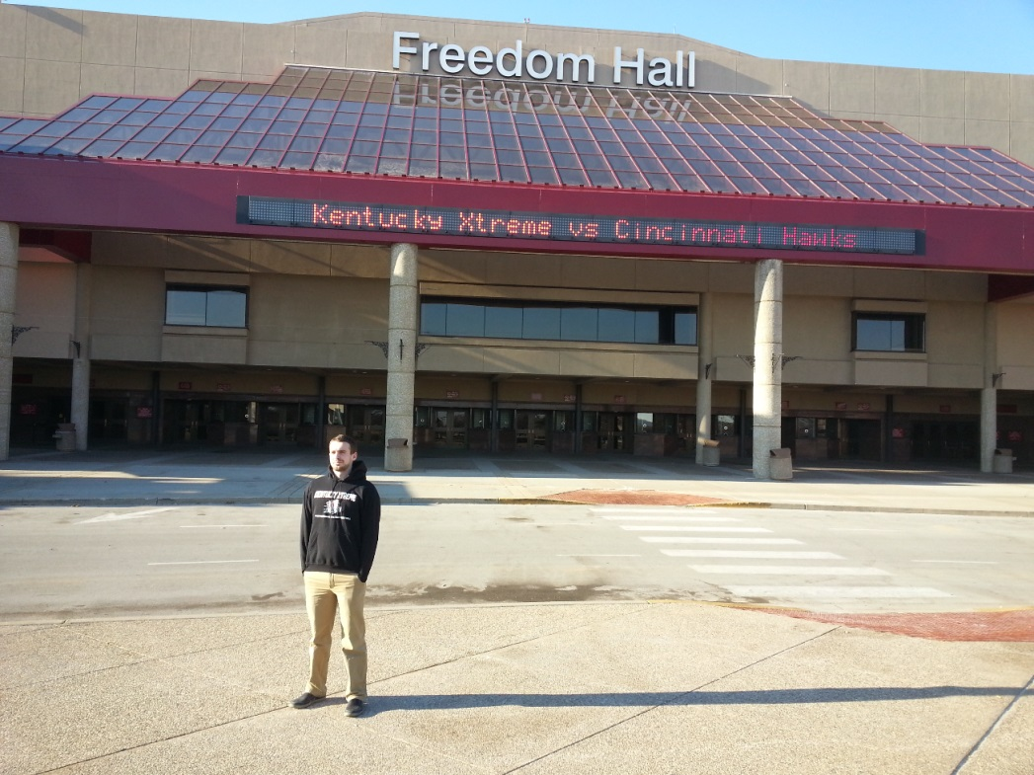
Will Reis
Marketing Intern
StrADegy Advertising
Sports Writer/Marketing Intern
Kentucky Extreme

Slide 31
Amanda Riedl
Public Relations Intern
Runswitch Public Relations

Slide 32
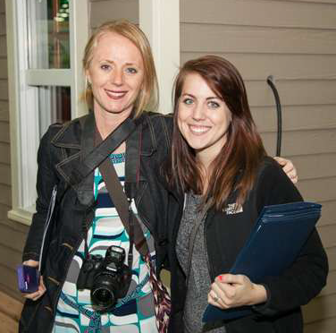
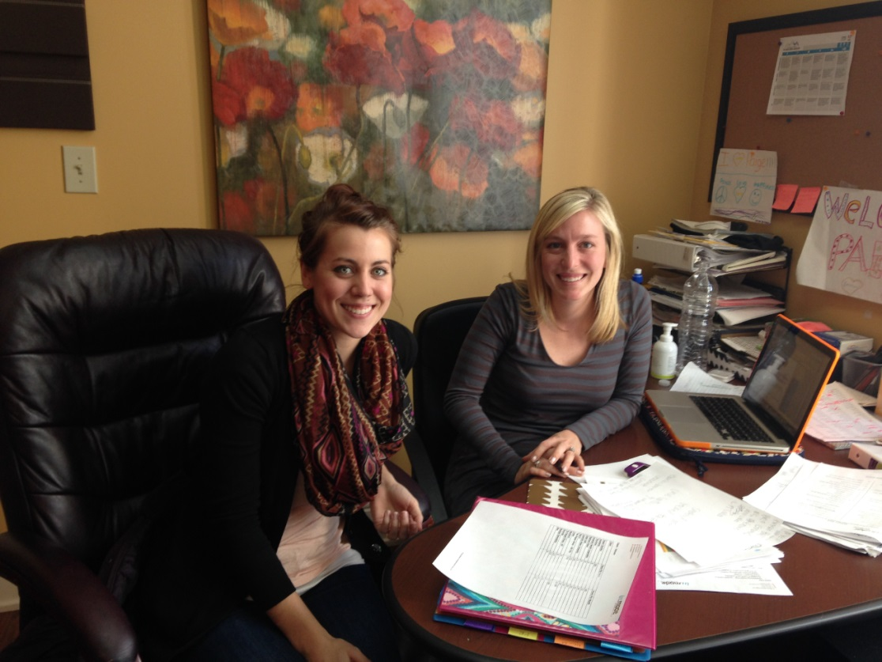

Madelaine Ruggles
Marketing Intern
Summit Media Corporation
Marketing Intern
in.Mode Marketing

Slide 33
Ashlie Stevens
Communications and Development Intern
Kentucky Youth Advocates

Slide 34
Tyler Wobbrock
Public Relations Intern
Make-A-Wish Foundation
Communications Intern
Muhammad Ali Center

Slide 35
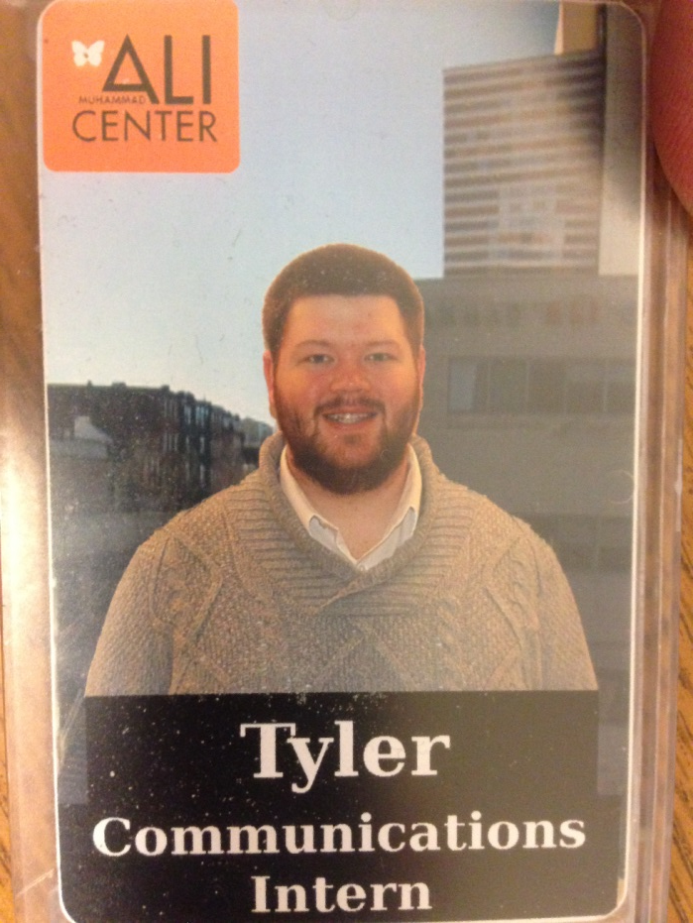
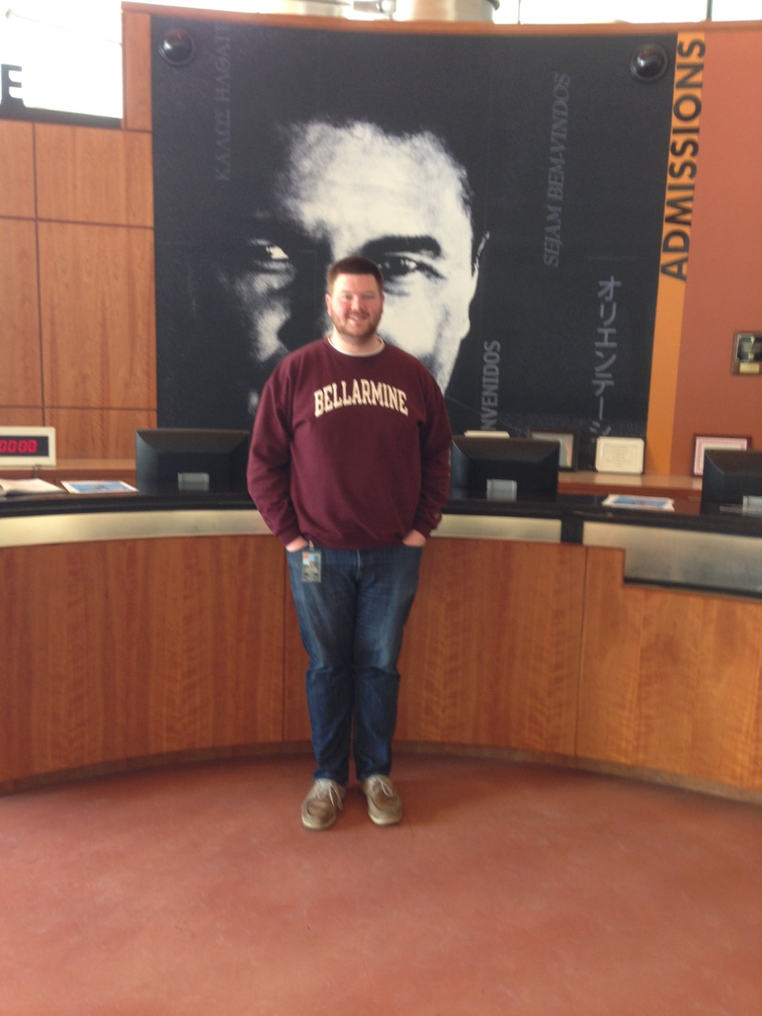
Tyler Wobbrock

