Slide 1
Bellarmine University
School of Communication
2013 Senior Internship Recognition

Slide 2
Lindsay Batts
Director of Career Peers
Bellarmine Career Development
Communication Intern
Kentuckiana Girl Scouts
Communication Intern
Arthrex, Inc.

Slide 3
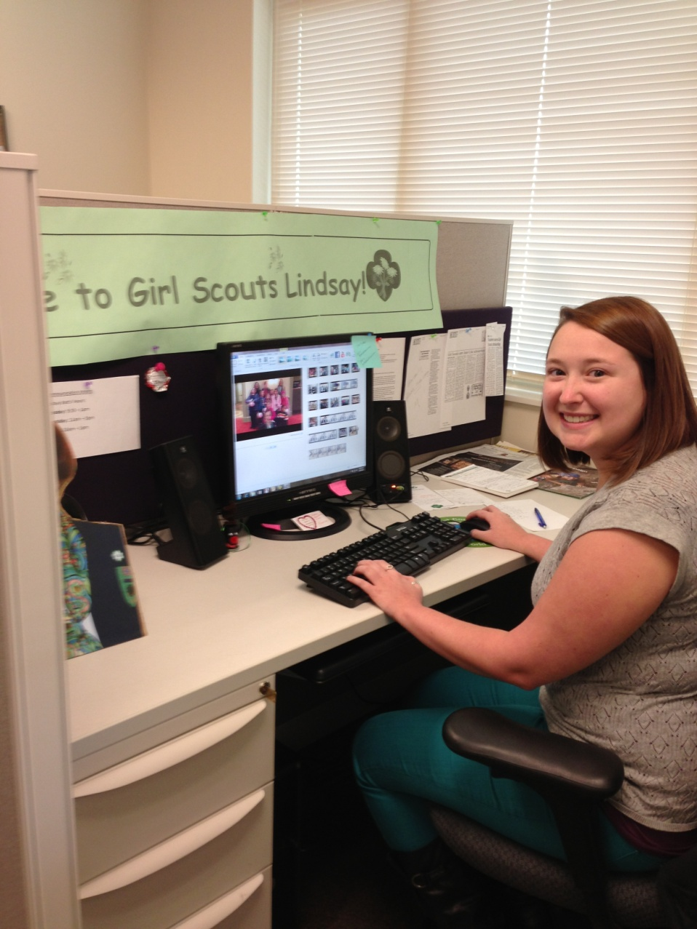

Lindsay Batts

Slide 4
Vincent Clark
Communication Intern
People Strategies Consulting

Slide 5
Elizabeth Coons
Communication Intern
Valeo Magazine
Communication Intern
Yum! Brands

Slide 6
Brian Couchot
Social Media Intern
Bellarmine Admissions Office

Slide 7
Christopher Dowe
Media Intern
WLKY

Slide 8
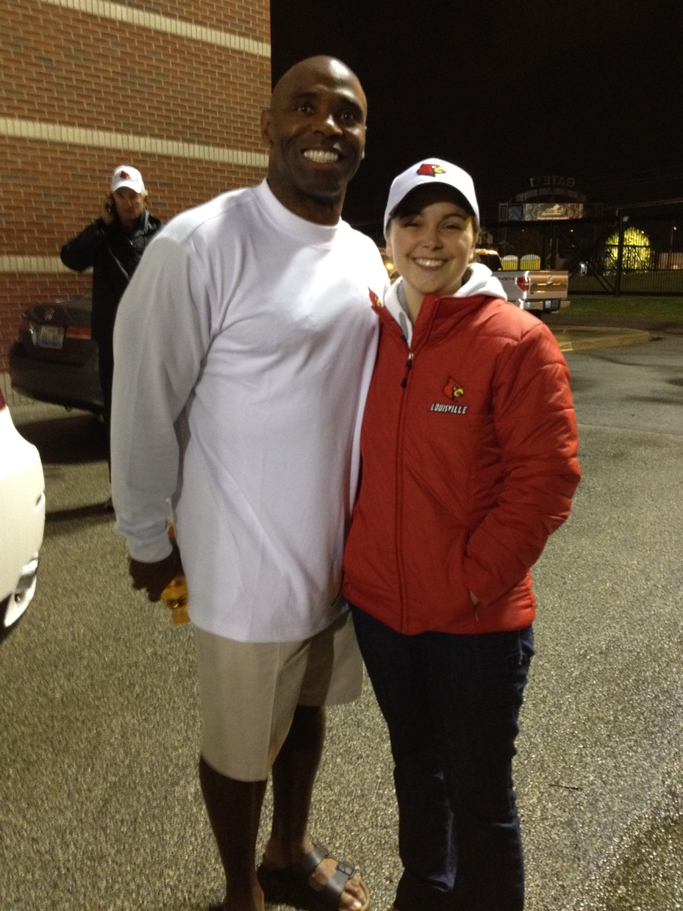
Kelsey Duvall
Production Intern
WHAS 11 Sports

Slide 9
Chasiti Gaines
Law Clerk & Communication Intern
Smith & Helman

Slide 10
Kathryn Connor Galle
Broadcast Intern
WHAS 11

Slide 11

Sydney Godsey
Marketing and PR Intern
The Louisville Zoo

Slide 12
Jennifer Greb
Video Intern
Bellarmine Academic Resource Center

Slide 13
Karyn Hickey
Social Media Intern
THIS...is Louisville

Slide 14
Alissa Hicks
Marketing Intern
Valhalla Golf Club/PGA Championship

Slide 15
Raymond Hupfer
Sports Marketing Intern
Bluegrass Revolution
Digital Marketing Intern
St. Luke Institute
Social Media Intern
Sam Swope Auto Group

Slide 16
Matthew Sean Klosterman
Public Relations Intern
PriceWeber Marketing Communications, Inc.

Slide 17
Michael Lau
Production Intern
Broadway Digital Live Shot & Production Studio

Slide 18
Sarah Milligan
Communication Intern
River Road Asset Management

Slide 19
Samantha Ortiz
Graphic Design Intern
Kentucky Museum of Art and Craft
Media and Marketing Intern
Water with Blessings
Communication Intern
American Heart Association
Graphic Design Intern
Georgetown News-Graphic

Slide 20
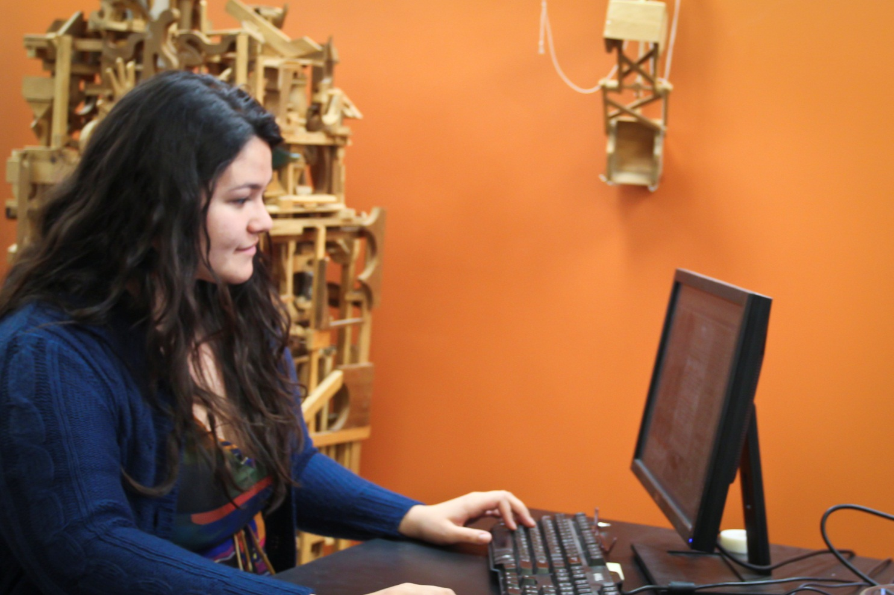
Samantha Ortiz

Slide 21

Christopher Presley
Sports Intern
WAVE 3 News

Slide 22
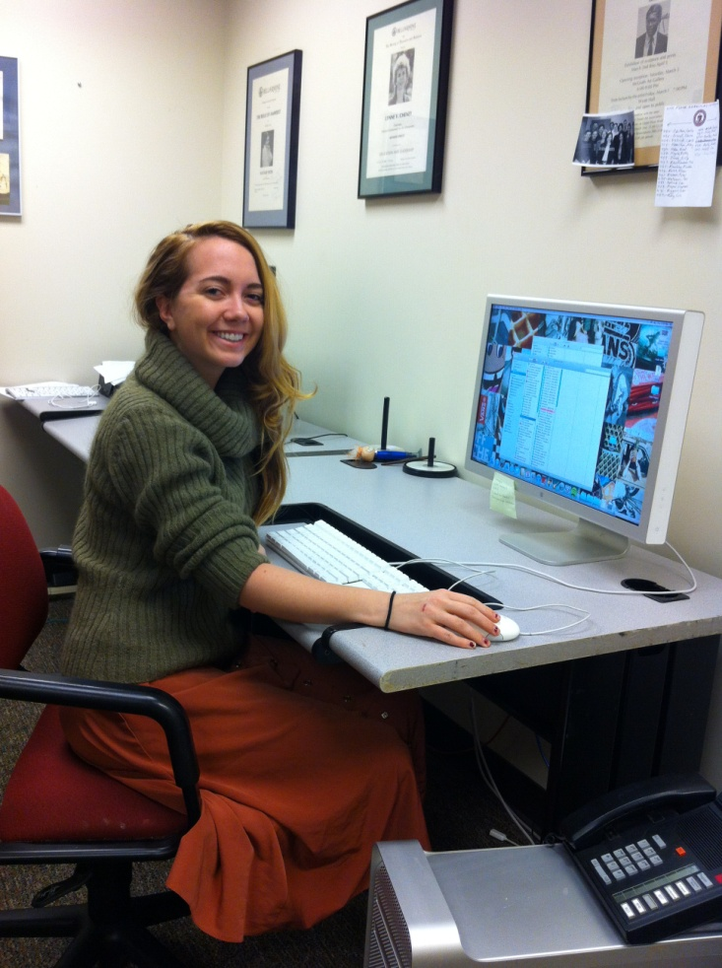
Tatiana Rathke
Communication Intern
Bellarmine Communication and Public Affairs Office

Slide 23
Victoria Reibel
PR Intern
Savage Rose Classical Theatre Company

Slide 24
David Shearn
Communication Intern
Bellarmine Sports Information Department

Slide 25
Emily Strobel
PR Intern
Kentucky Humane Society
Communication Intern
American Heart Association

Slide 26
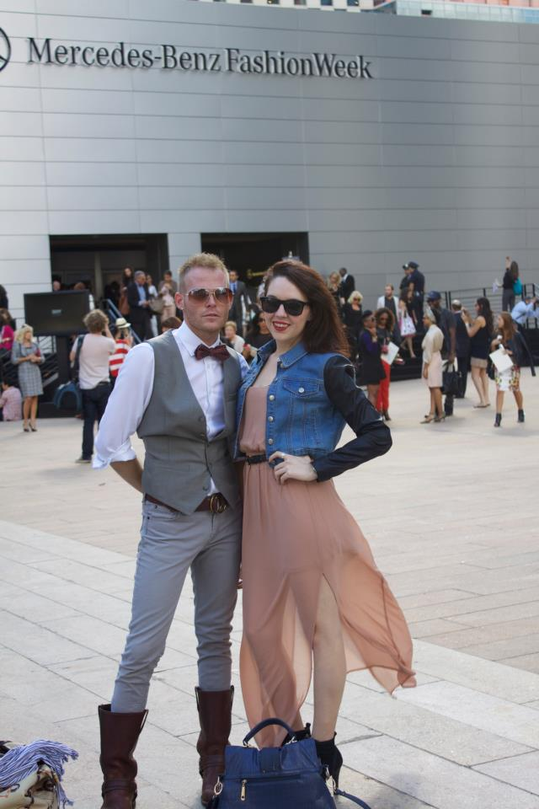
Adrienne Todd
Editorial Correspondent & Creative Assistant
C. Caswell Inc.

Slide 27
Jonathan Turl
Communication Intern
Bellarmine Admissions Office

Slide 28
Megan VanMeter
Communication Intern
WLKY

Slide 29
Olivia Welsh
Media & Marketing Intern
Water with Blessings
Marketing Intern
American Lung Association

Slide 30
Kaitlyn Whiteside
Journalism Intern
Louisville.com

Slide 31
Kohdy Woods
Communication Intern
Arts Council of Southern Indiana
Communication Intern
MetroTV

Slide 32
Kaitlin Young
PR Intern
Estes Public Relations

