Slide 1
2016 Senior Internship Recognition
Bellarmine School of Communication

Slide 2
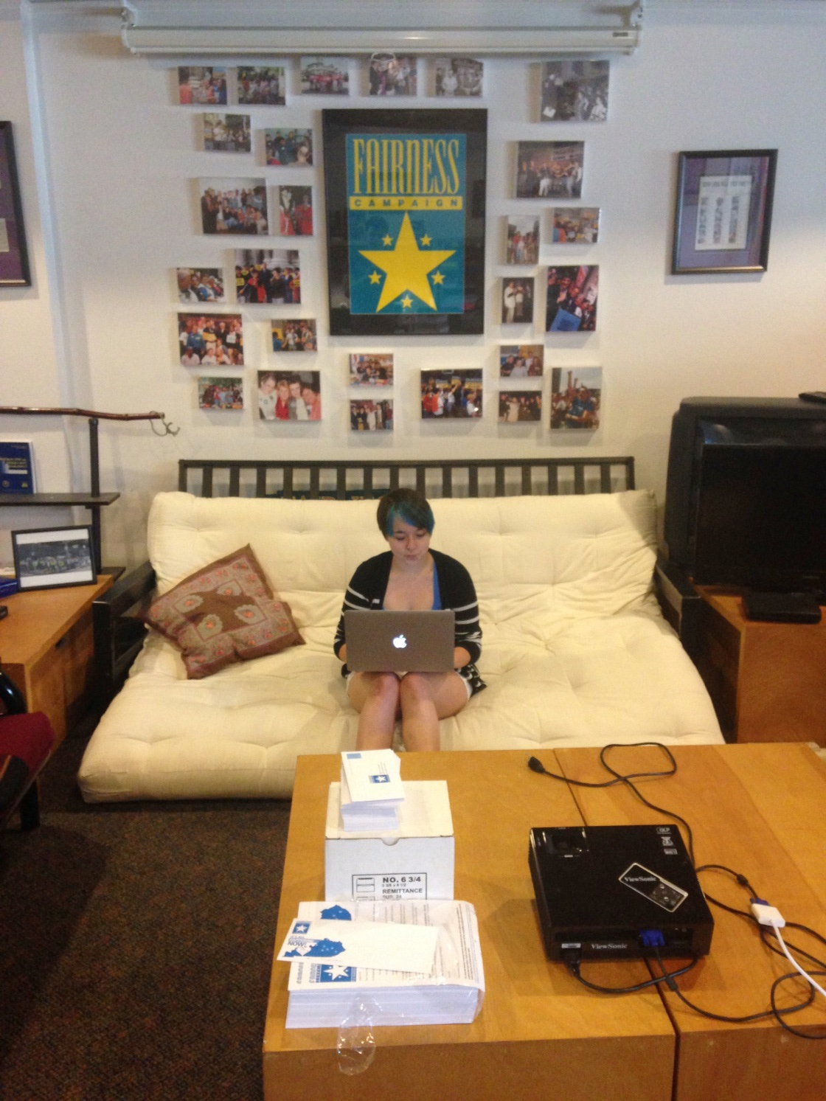
Haley Adams
Communication Intern
Fairness Campaign

Slide 3
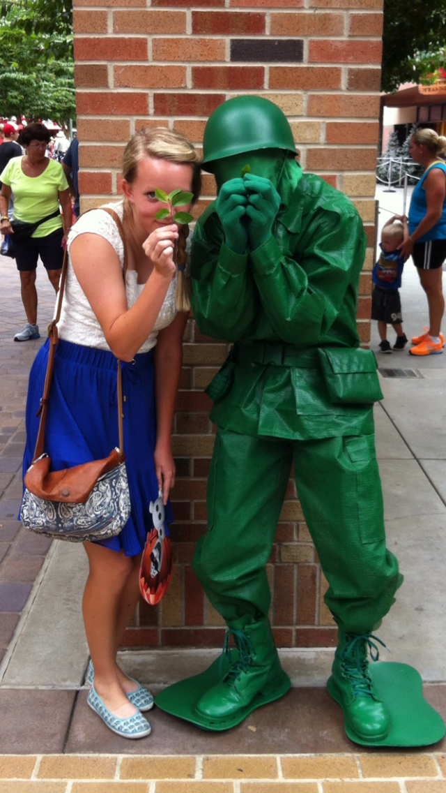
Jacob Arnold
Entertainment Intern
Disney College Program Walt Disney World

Slide 4
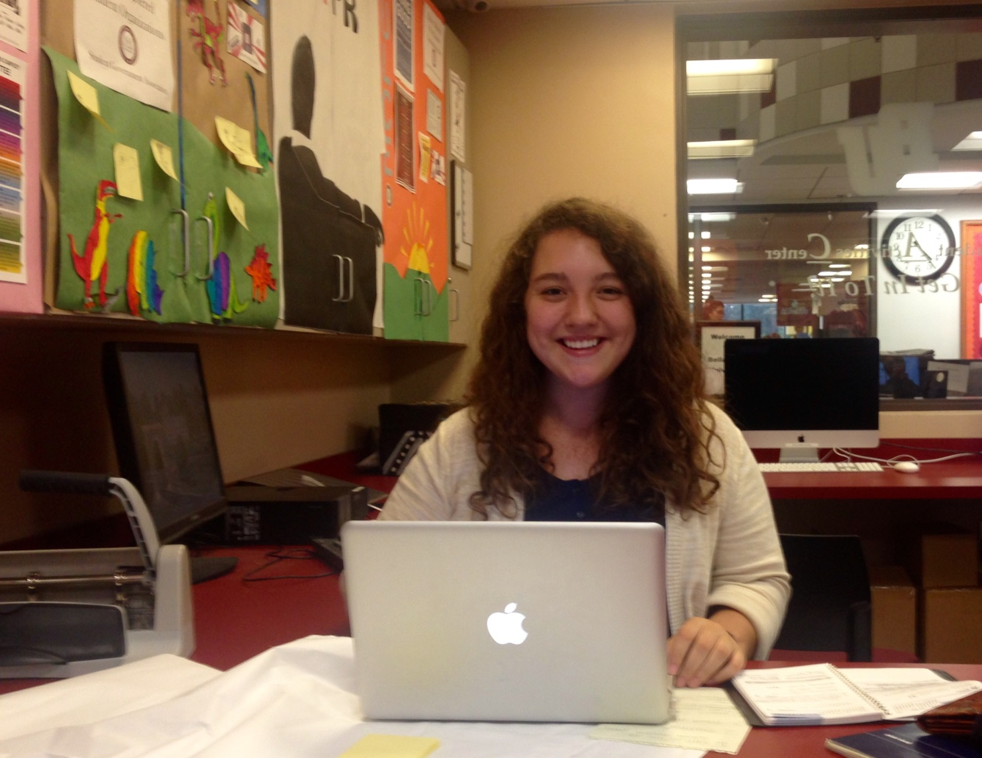
Gabrielle Ayers
Public Relations Intern Bellarmine Activities Council

Slide 5
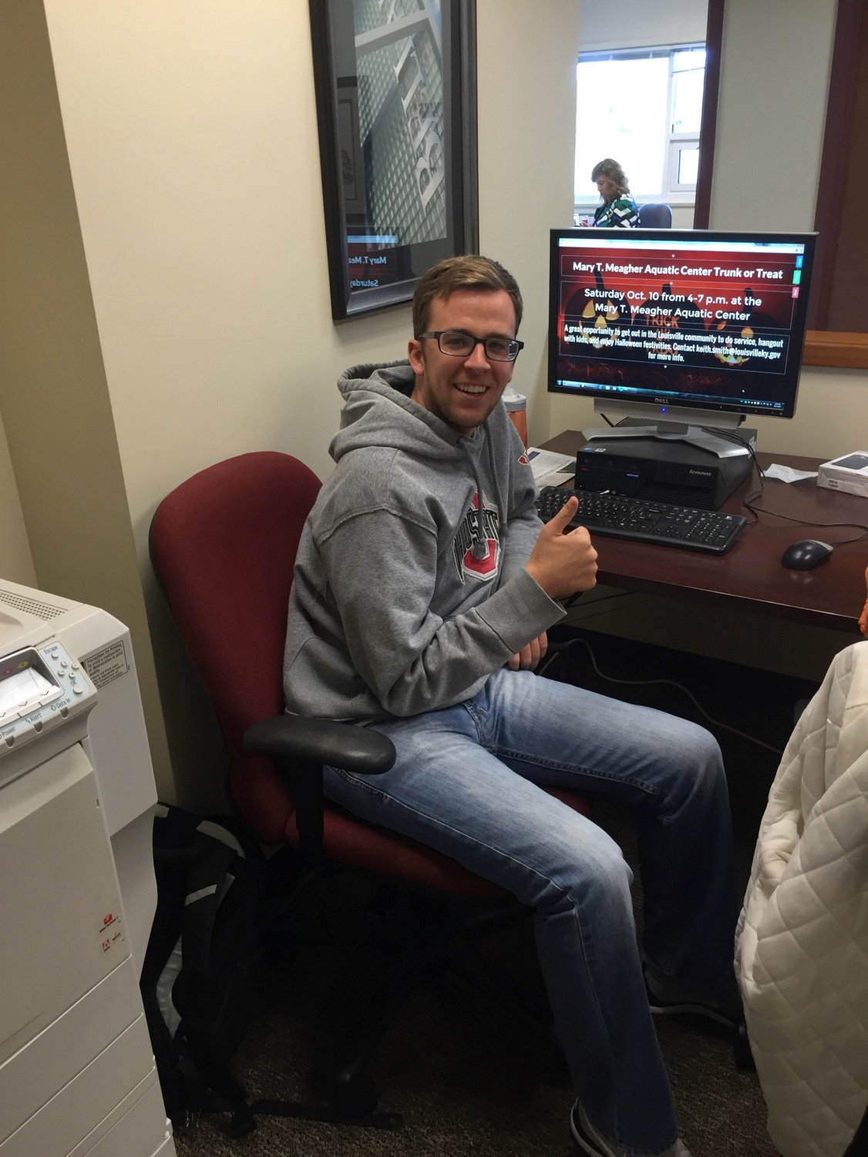
Drew Bilodeau
Public Relations Intern Bellarmine University Office of Communications and Public Affairs

Slide 6
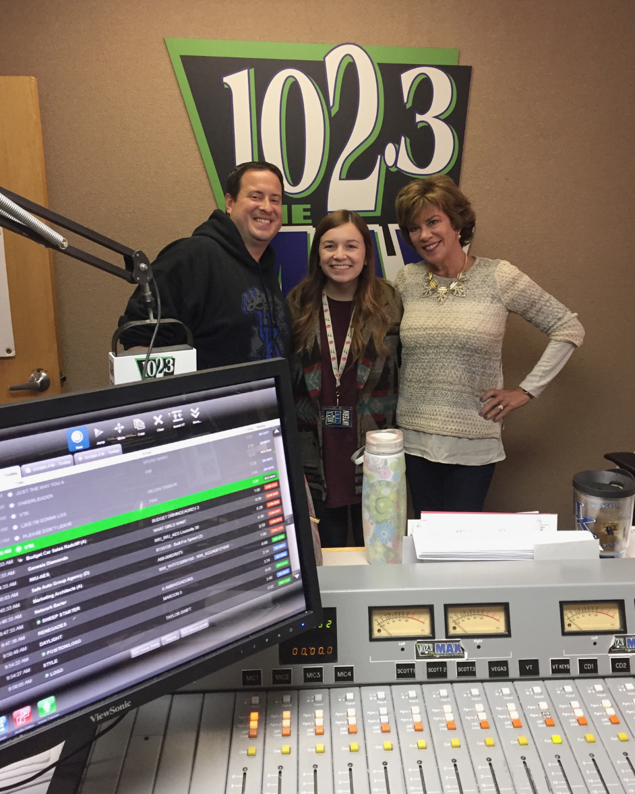
Kayla Coursey
Radio Intern
WXMA 102.3 The Max
Communication Intern Nfocus Magazine

Slide 7
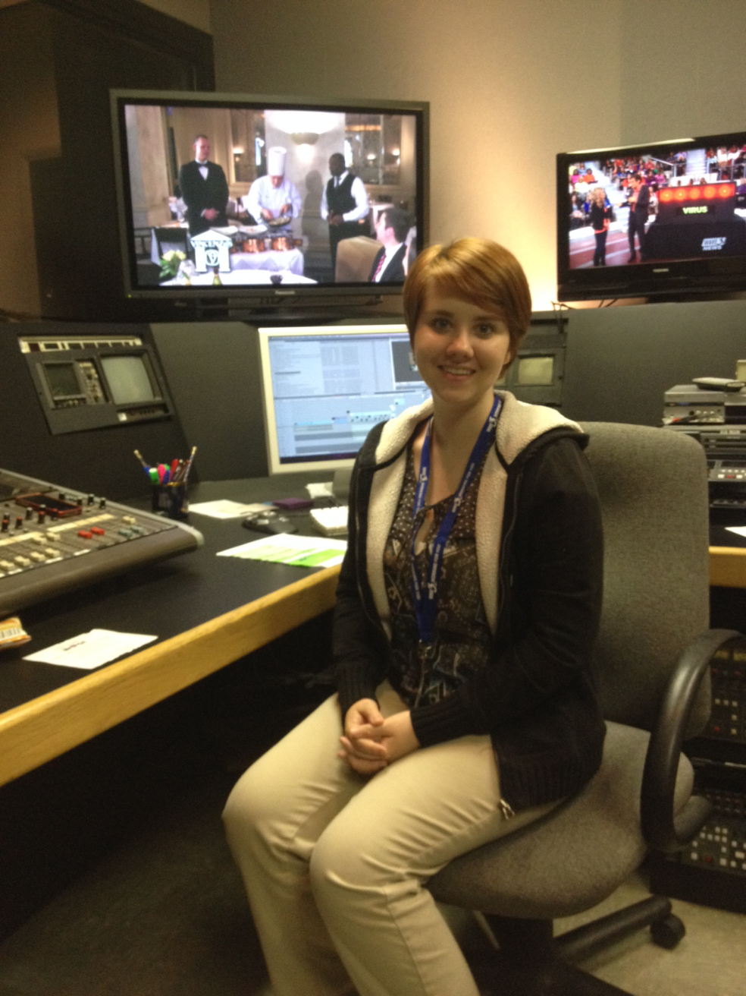
Kayla Davis
Television Intern
WAVE 3 TV

Slide 8
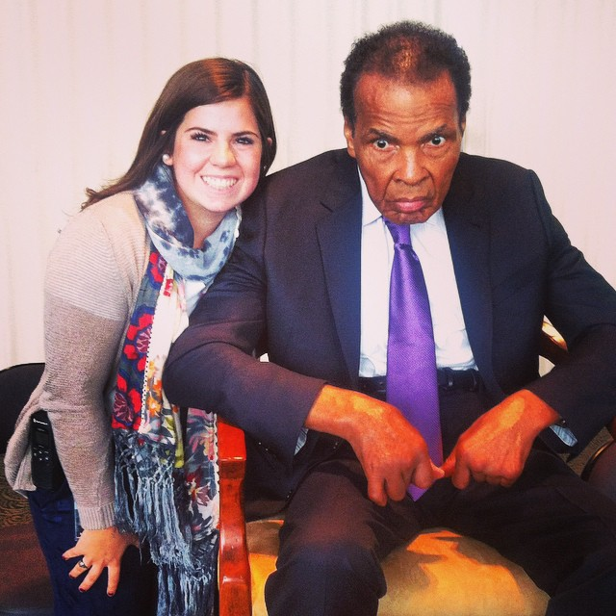
Anna Duzane
Special Events Intern Muhammad Ali Center

Slide 9


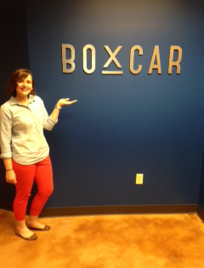
Brianna Ellis
Public Relations Intern Bandy Carroll Hellige
Development Intern
Boys and Girls Haven
Public Relations Intern
Boxcar PR

Slide 10
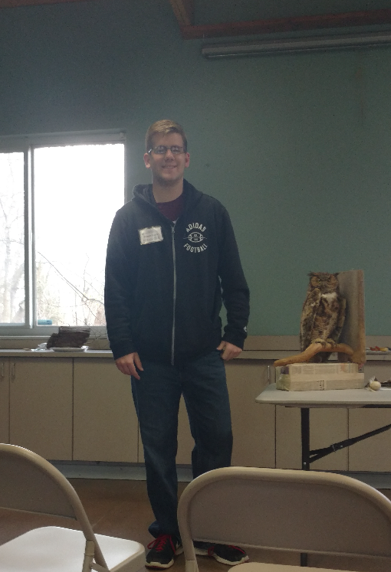
Joseph Exeler
Communication Intern Louisville Nature Center

Slide 11
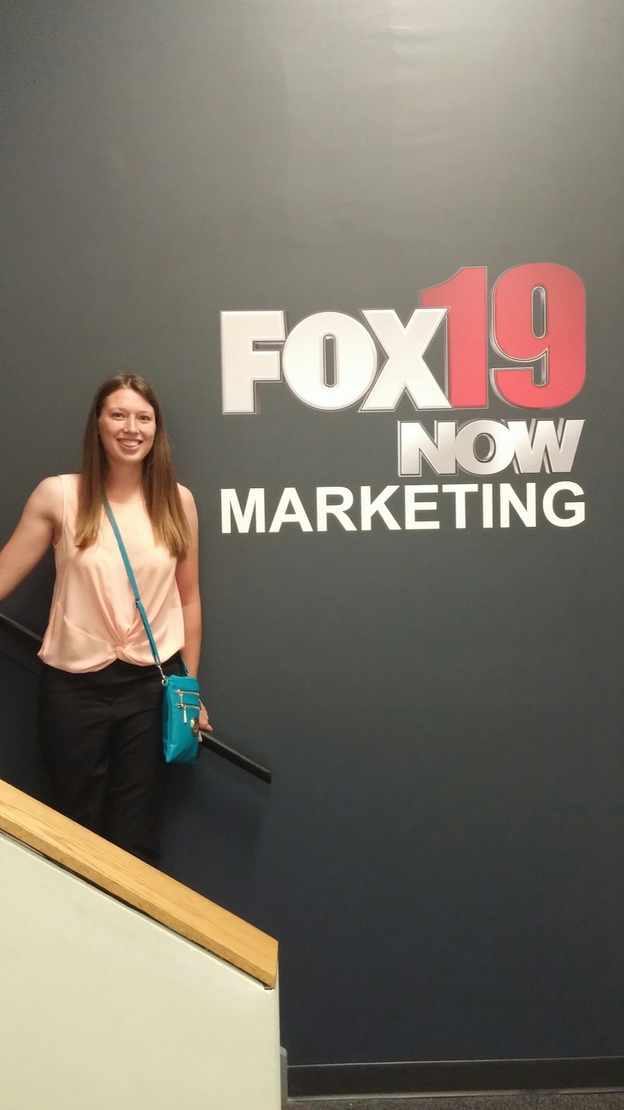
Amy Feie
Marketing Intern
Fox 19
Sports Intern
Western & Southern Tennis
Open

Slide 12

Kelli GOings
Photography Intern Louisville.com/Louisville Magazine

Slide 13
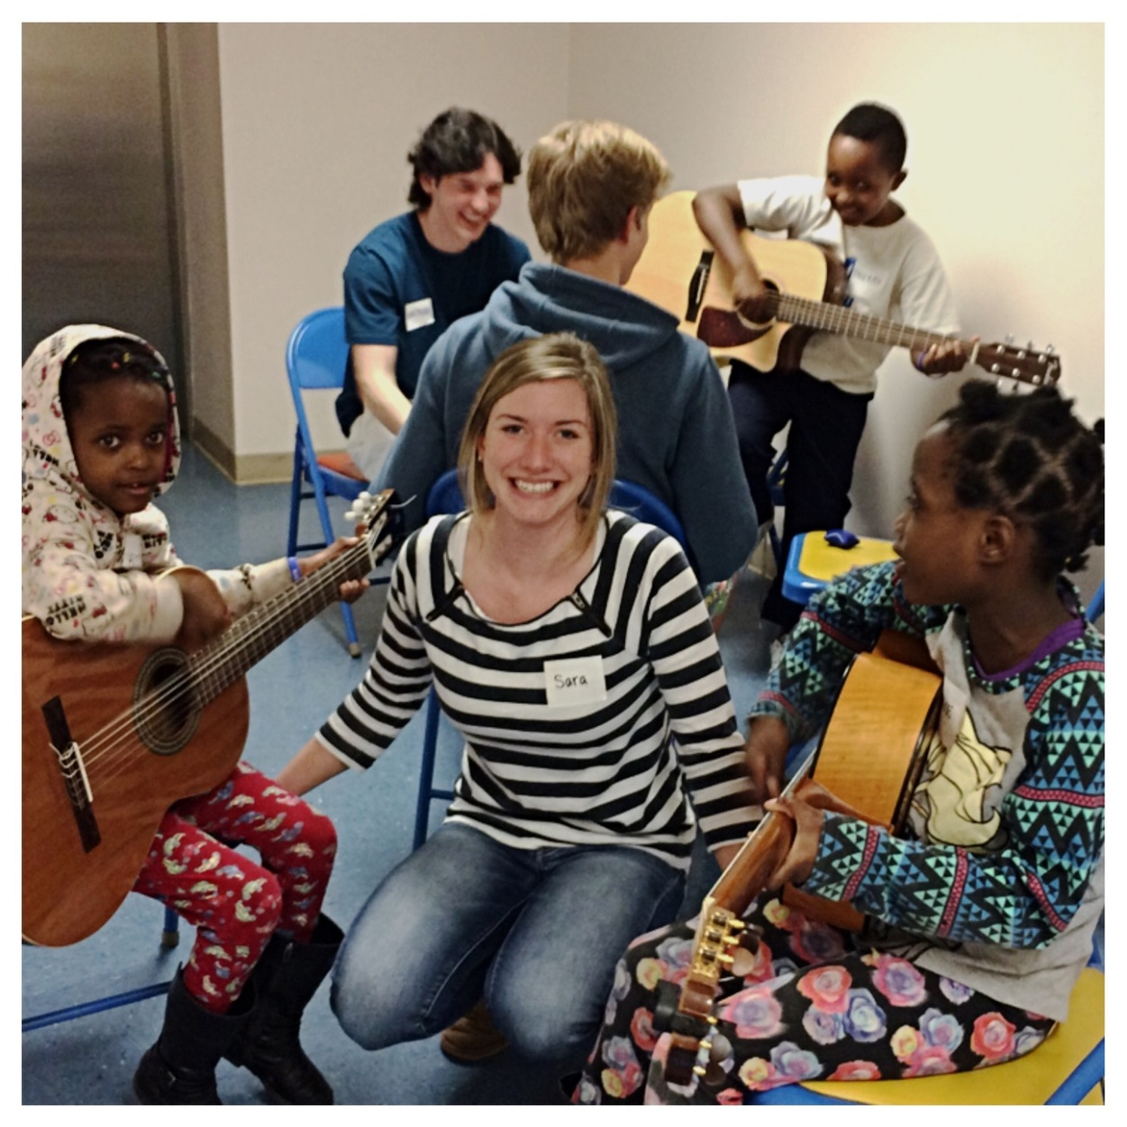
Sara Harris
Communication Intern Louisville Free Public Library

Slide 14

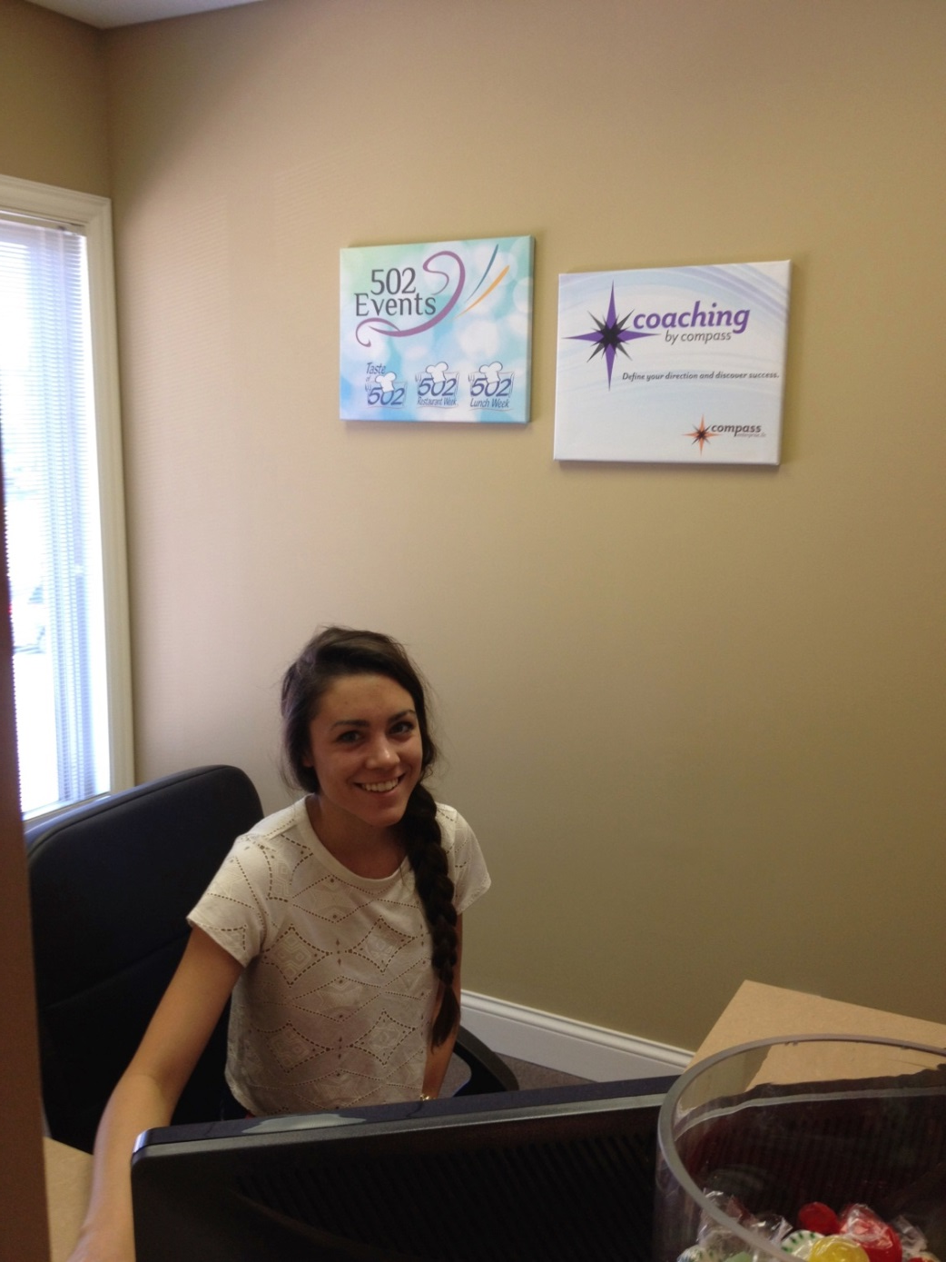

Jennifer Hartmann
Marketing Intern
UofL Get Healthy Now
Communication Intern
Bellarmine University SuRF Center
Event Planner/Intern
502 Events

Slide 15
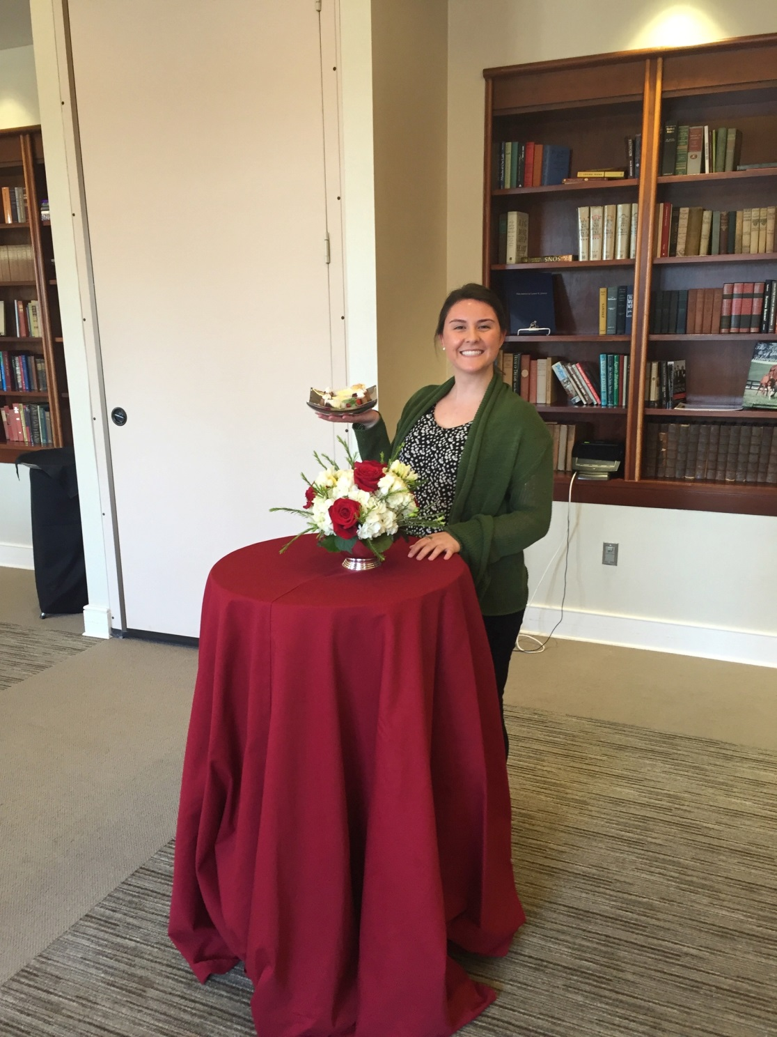
Ellie Hecht
Special Events Intern Bellarmine University Department of Special Events.

Slide 16
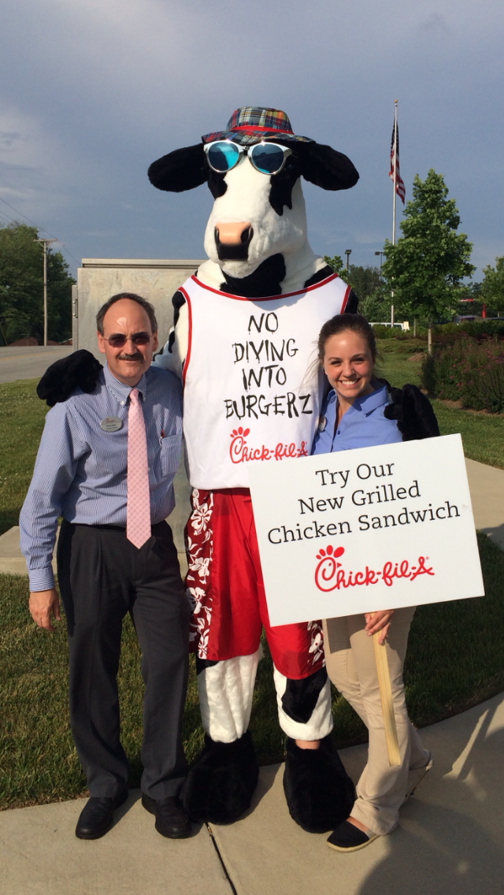
Taylor Humphrey
Marketing Intern
Chick-Fil-A Glenmary

Slide 17
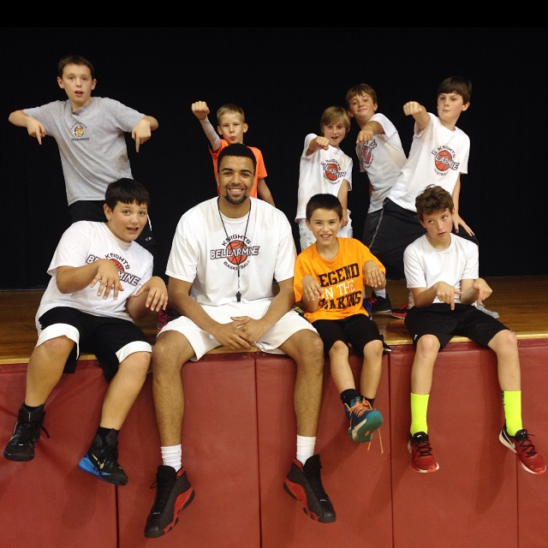
Yasin Kolo
Sports Intern Bellarmine University Boys Basketball Camps

Slide 18
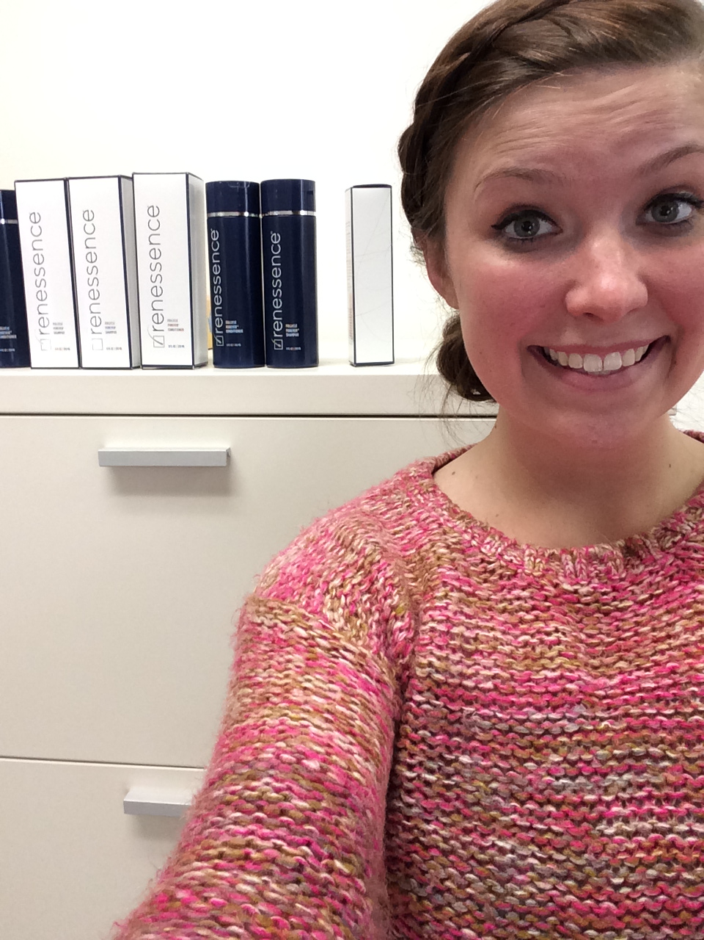
Claudia Lab
Marketing Intern Renessence Hair

Slide 19

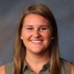

Claire McCormick
Broadcast Intern
99.7 WDJX
Digital Marketing Intern
Honeywick LLC

Slide 20
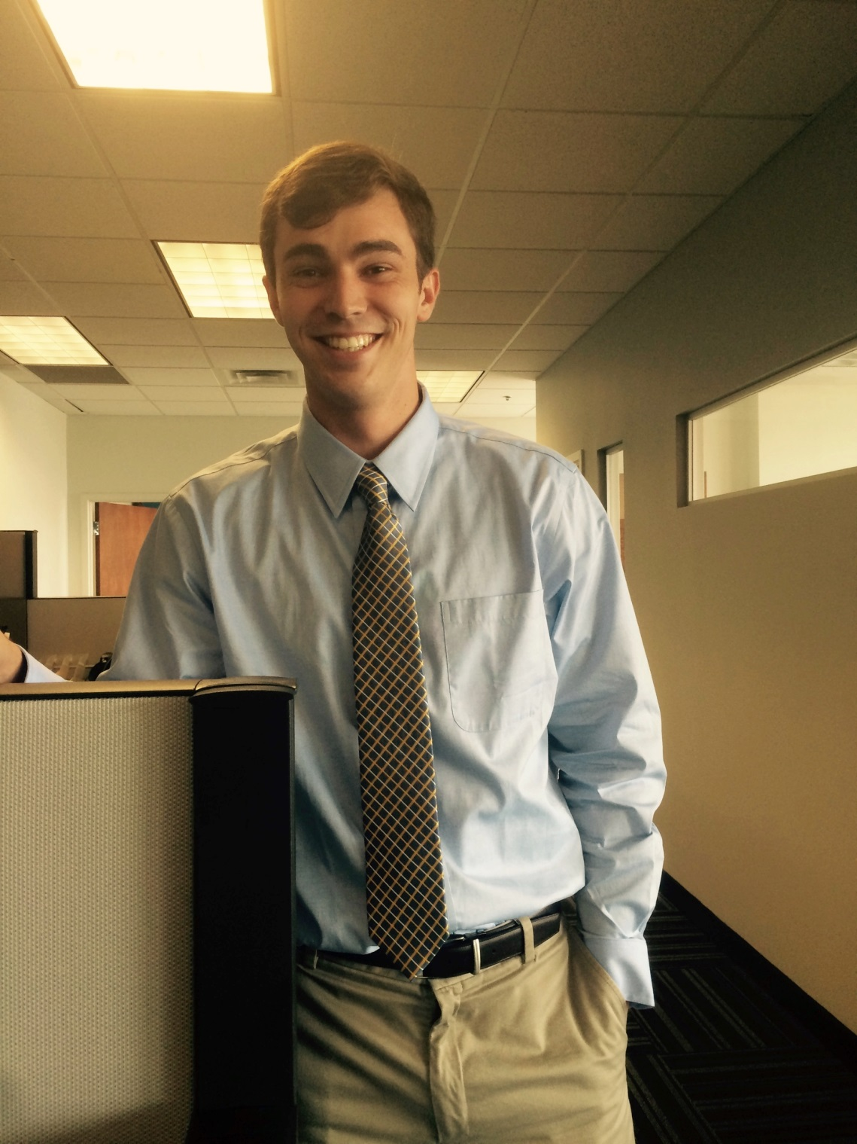
Connor Murphy
Inc.credible Awards Intern Greater Louisville Inc. Metro City Chamber of Commerce

Slide 21
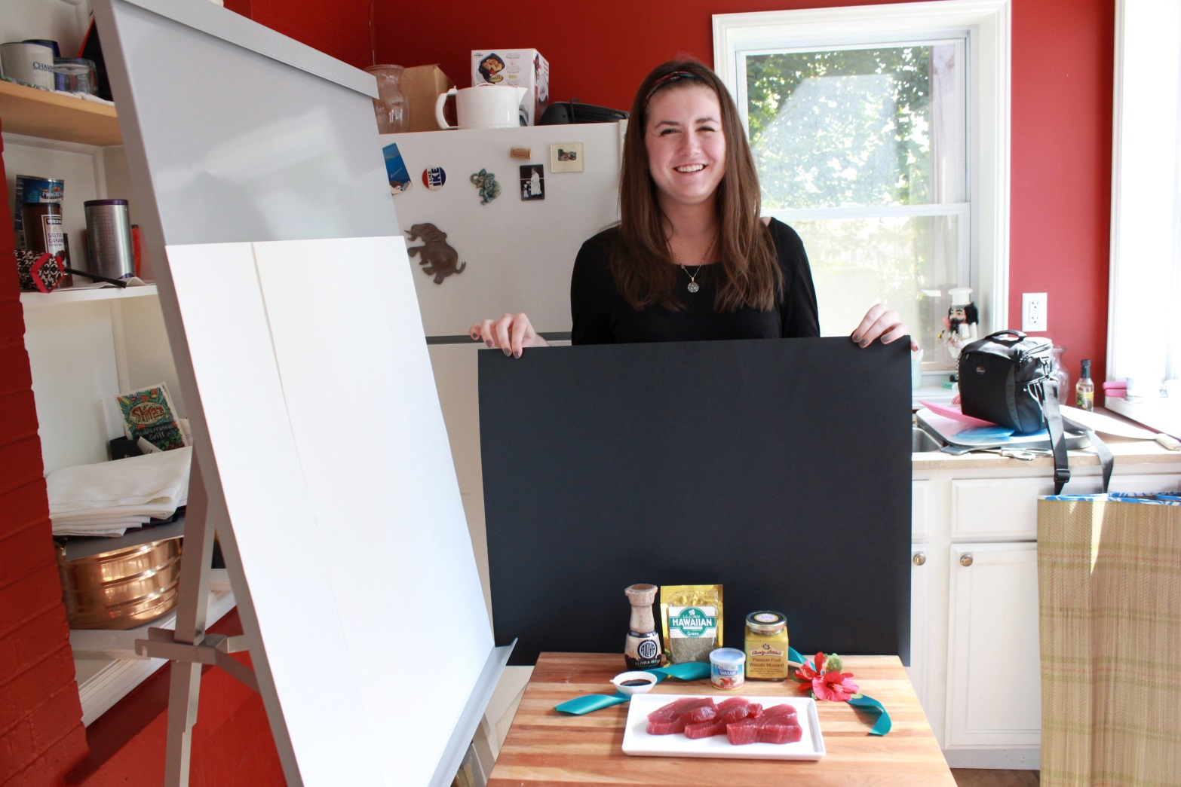
Ashlee O’Neil
Public Relations Intern
Estes Public Relations

Slide 22
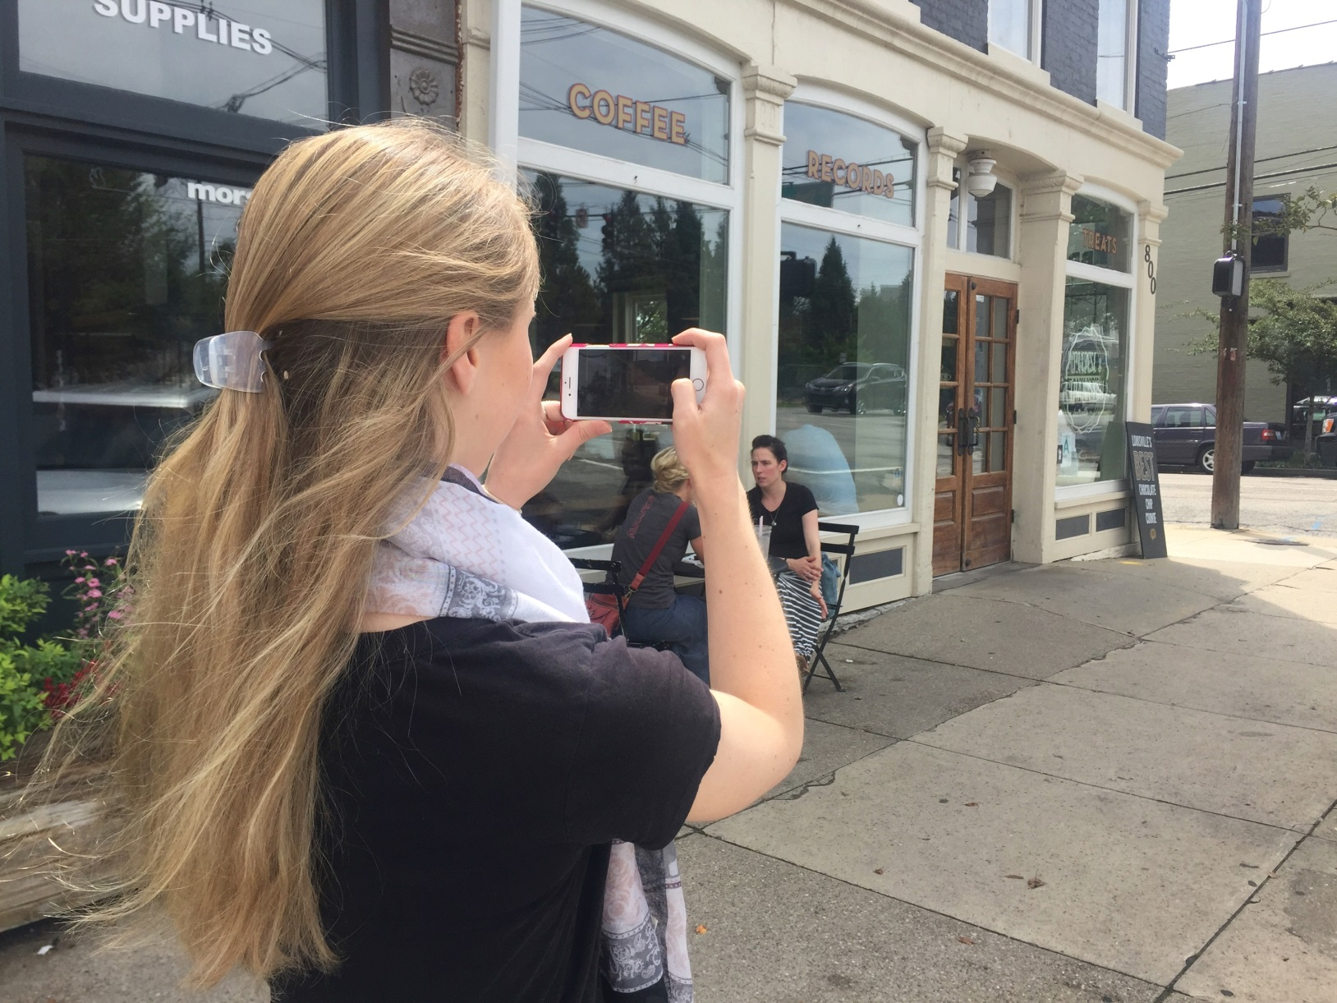
Aly Rauen
Marketing Intern
in.Mode Marketing

Slide 23
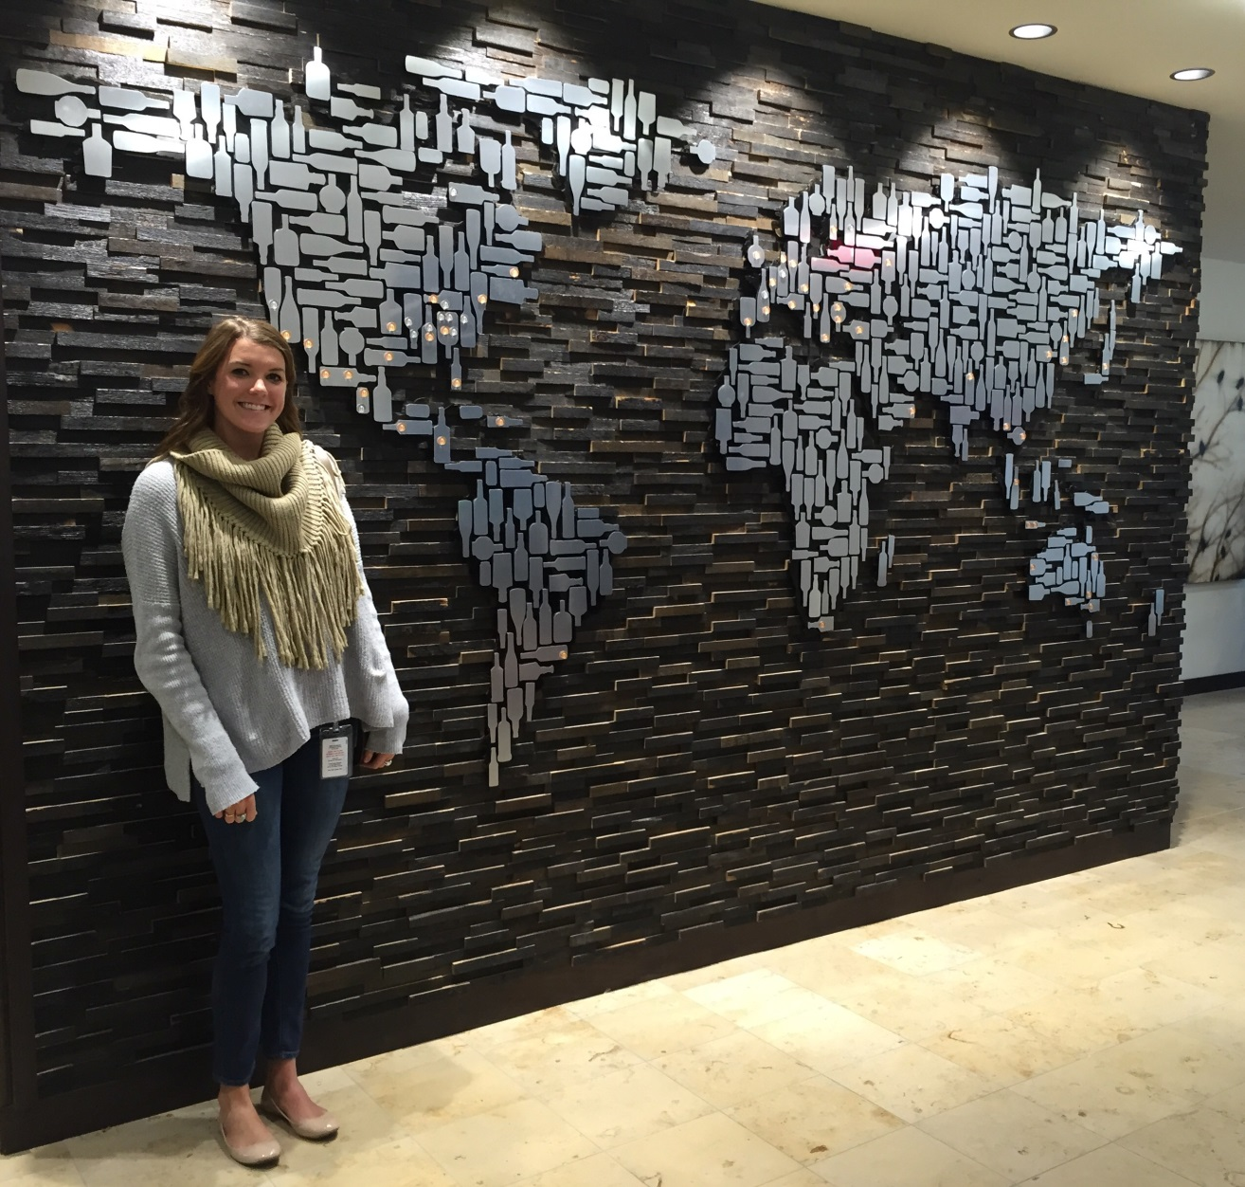
Olivia Reibel
Public Relations Intern Brown-Forman Corporation

Slide 24
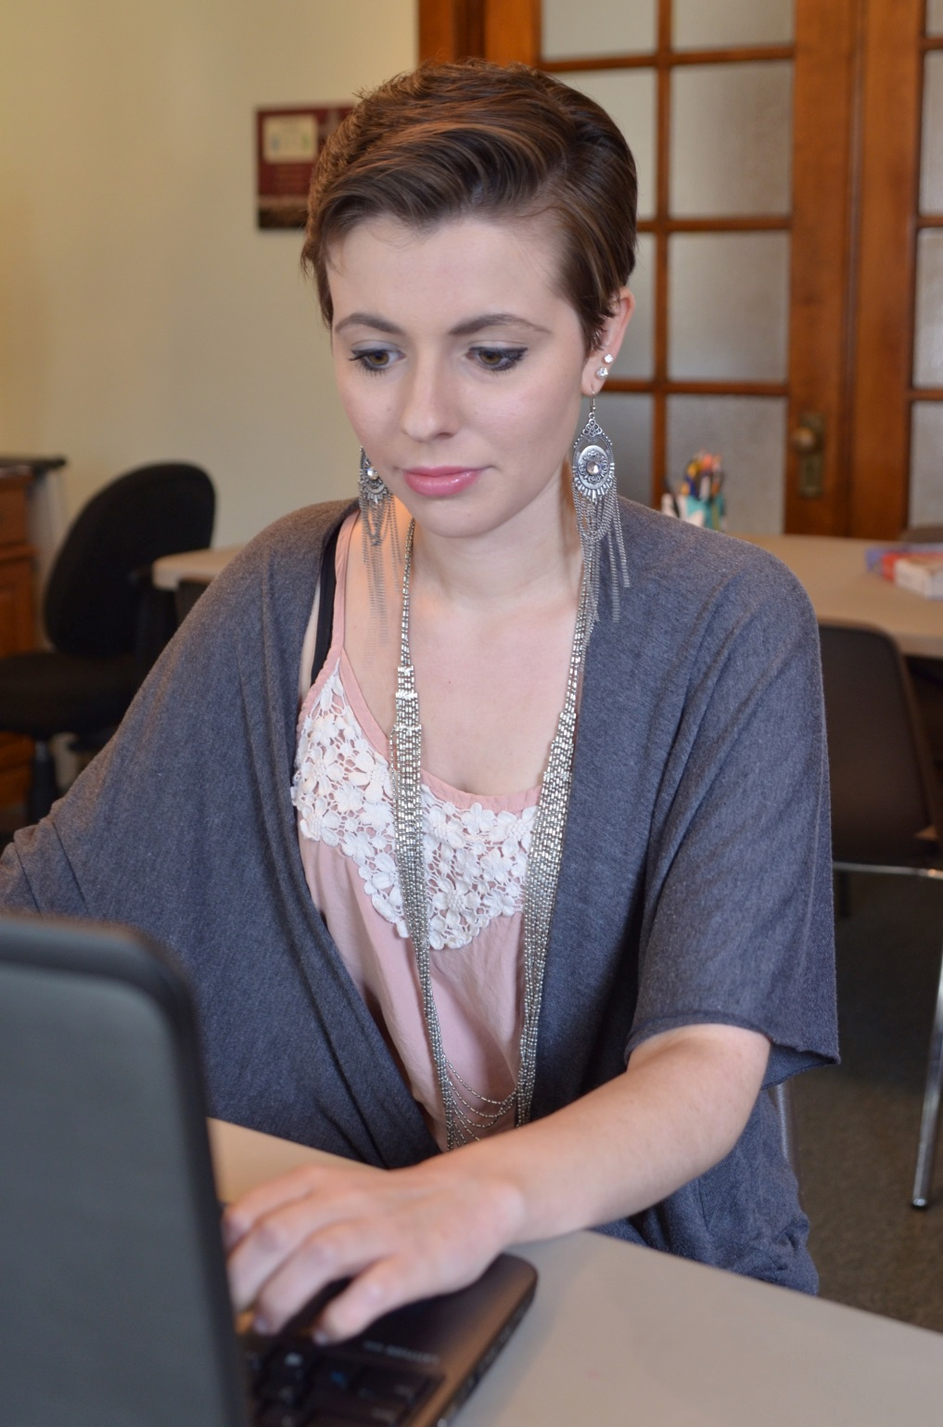
Emma Rhoderick
Graphic Communication Intern
Doors To Hope

Slide 25
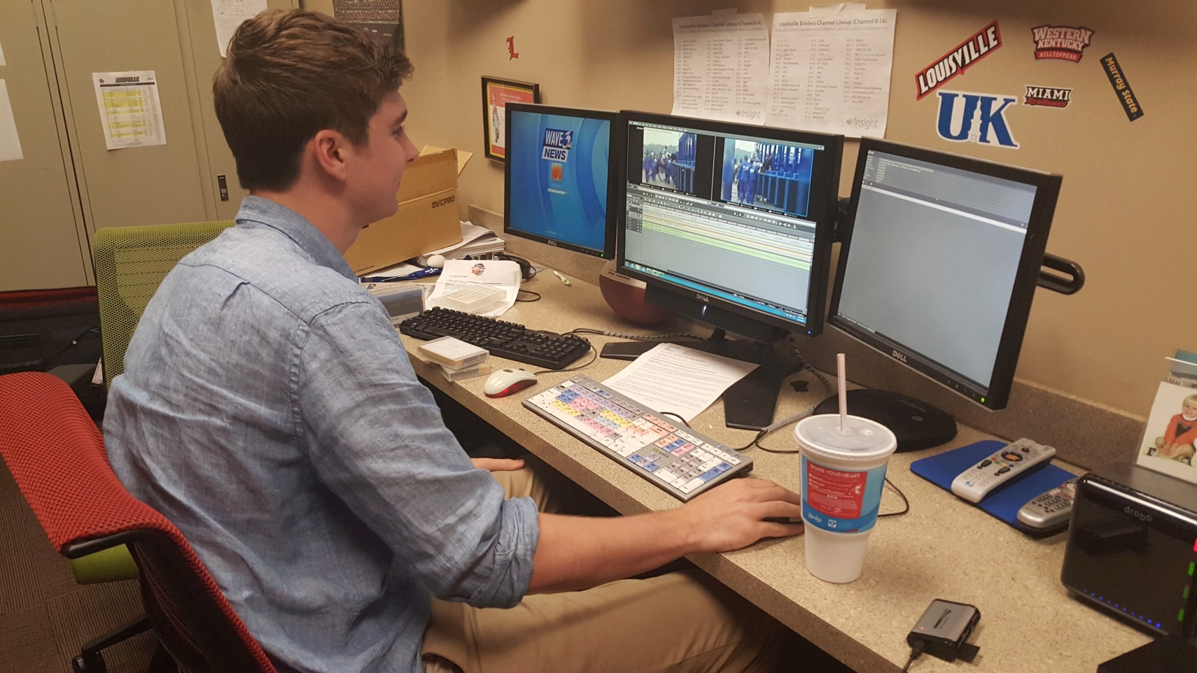
George Suggs
Sports Intern
WAVE 3 News

Slide 26
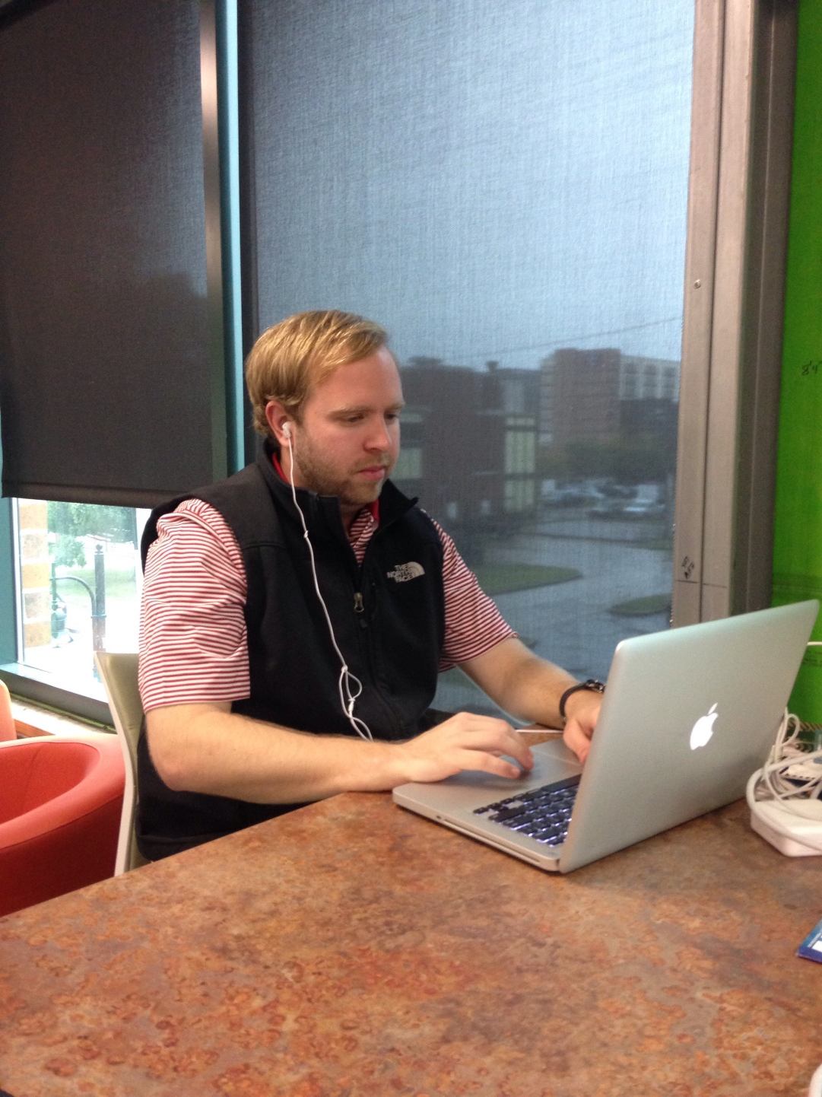
taylor Wagner
Sales & Marketing Intern Interapt, LLC

Slide 27
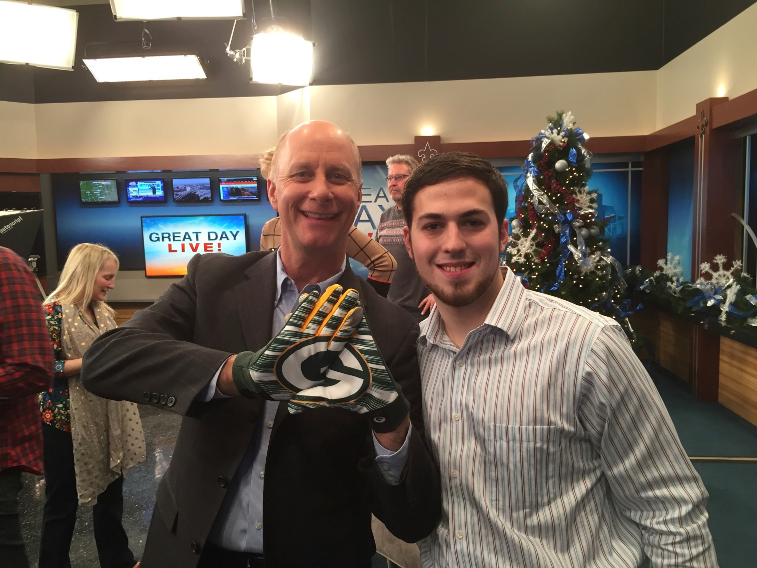
Jordan Wheatley
Production Assistant
WHAS11 Great Day Live!

Slide 28
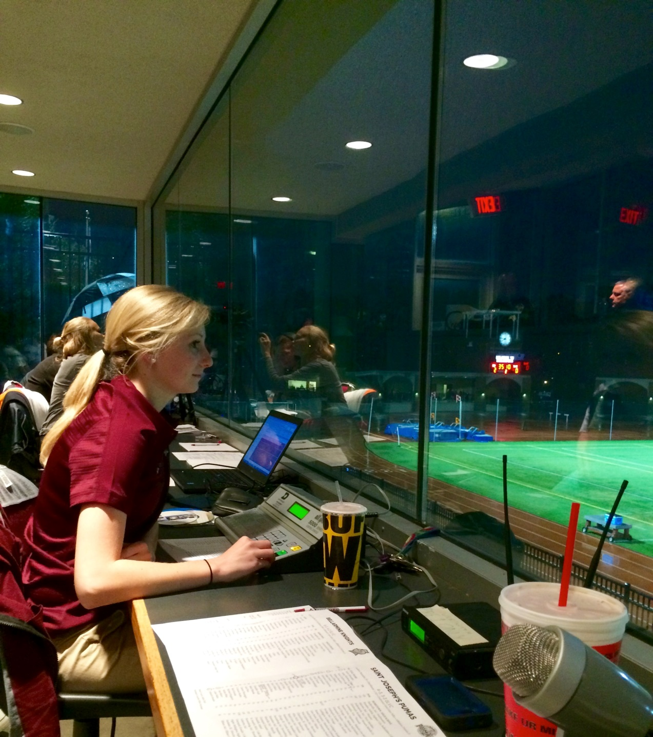
Sydney Windell
Communication Intern
Bellarmine University Sports Information

