Slide 1
Class of 2017 Internships

Slide 2
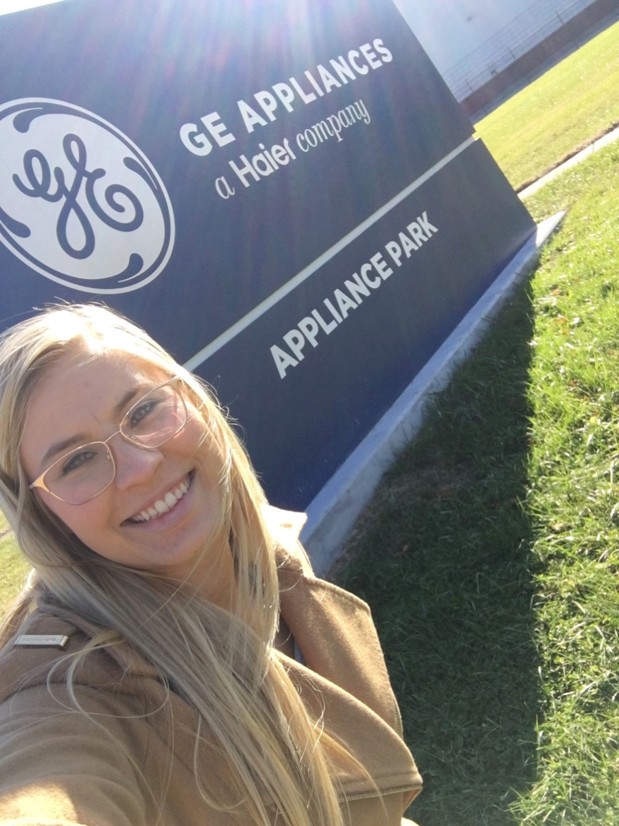
Maryashley Betz
Digital Marketing Intern GE Appliances

Slide 3
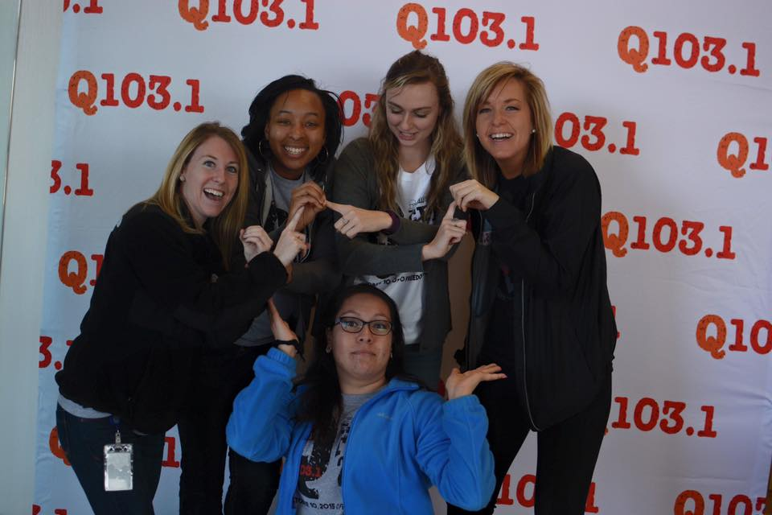
Tara Bowling
Communication Intern Summit Media
Digital Marketing Coordinator Presentation Academy

Slide 4
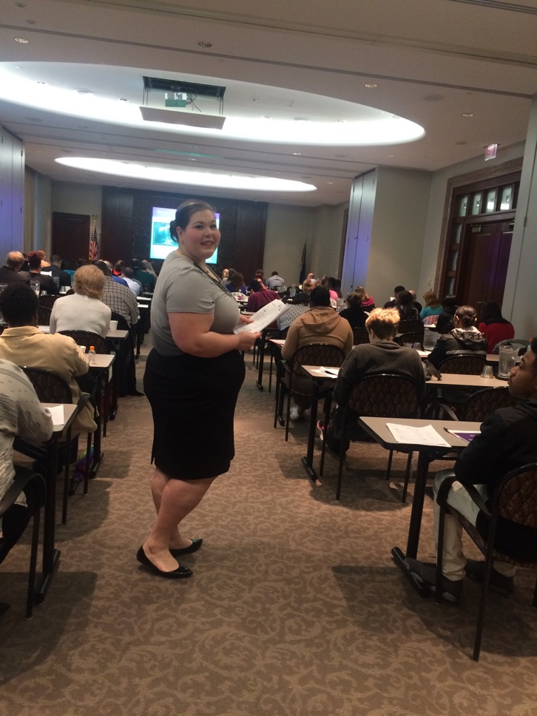
McKayla Chandler
Communication Intern KentuckyOne Health

Slide 5
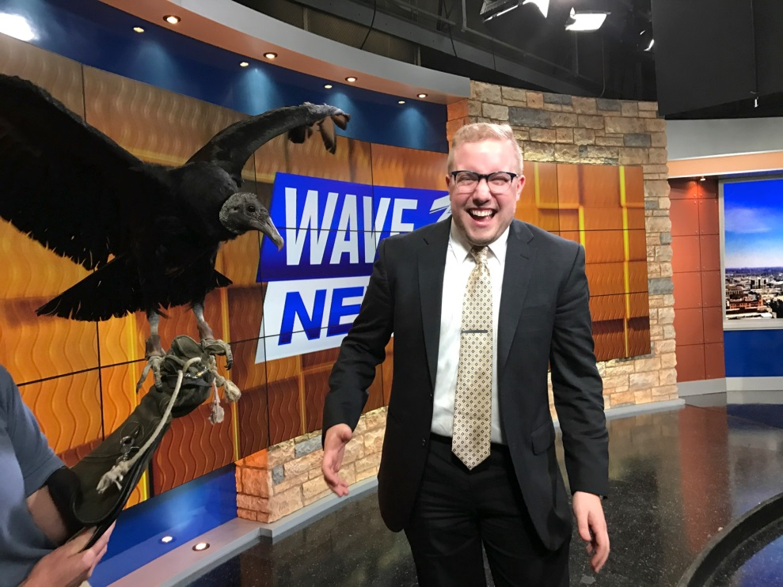
Evan Cox
Communication Intern Apple
Digital Marketing Intern Louisville Zoo

Slide 6
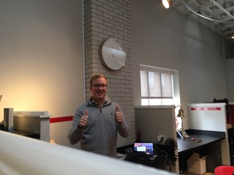
Ian Cox
Advertising Intern Fieldtrip

Slide 7
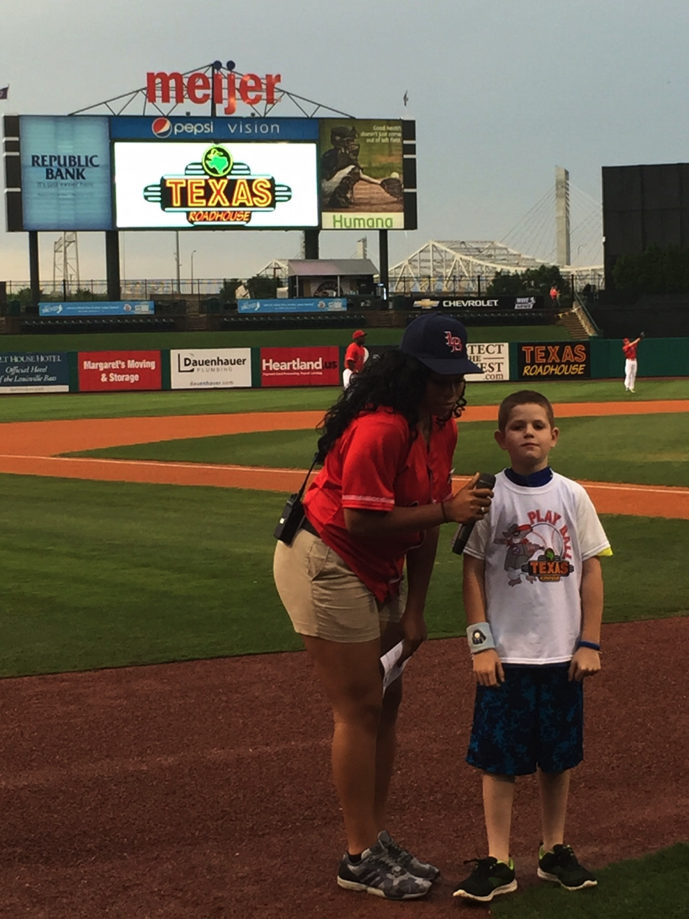
Destony Curry
Communication Intern Louisville Bats

Slide 8
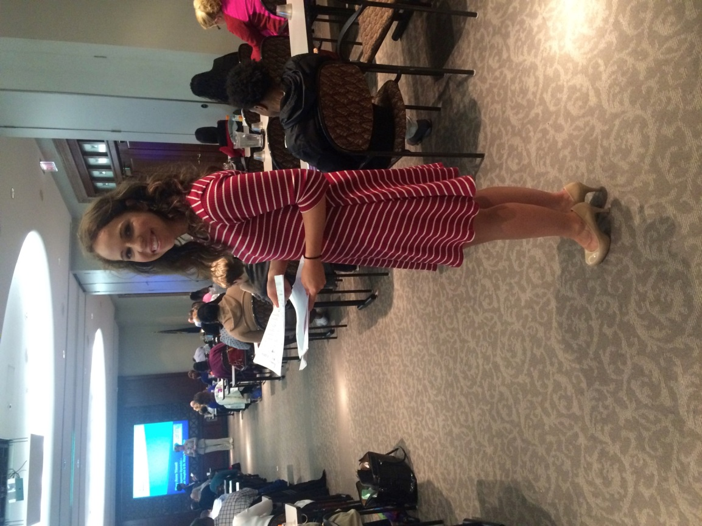
Beth Davish
Event Planning Intern KentuckyOne Health

Slide 9
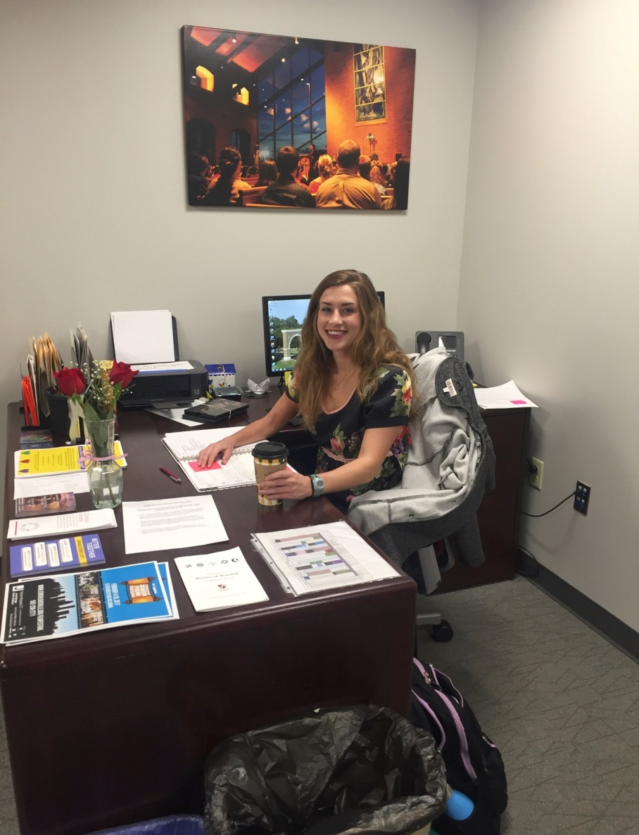
Ellie DeVries
Communication Intern Bellarmine Office of Campus Ministry

Slide 10
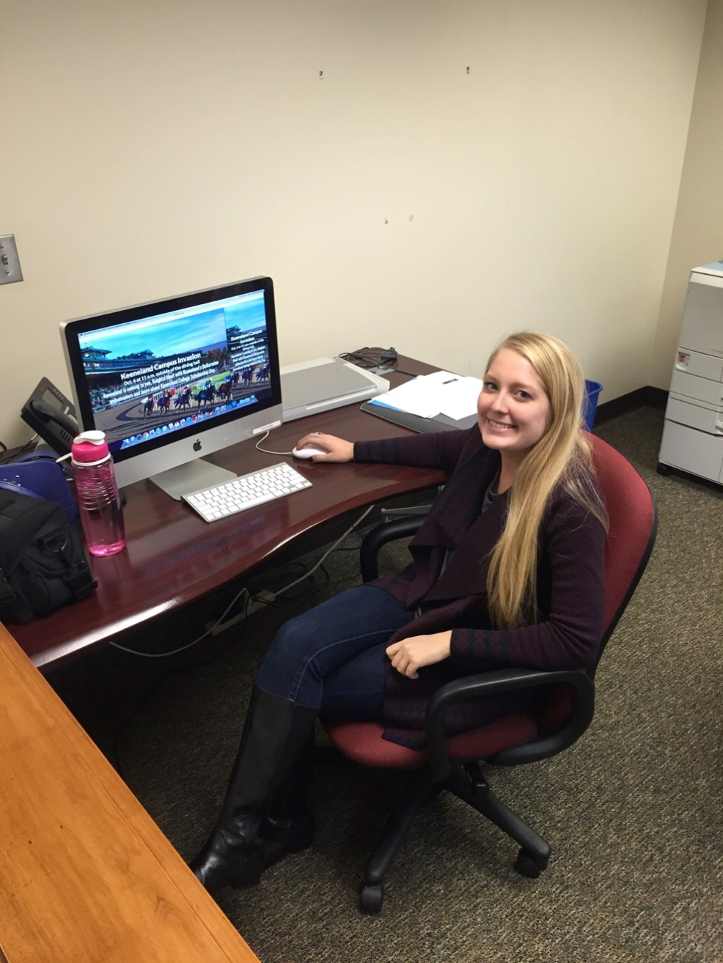
Emily Gahafer
Communication Intern Bellarmine Office of Communication and Public Affairs

Slide 11
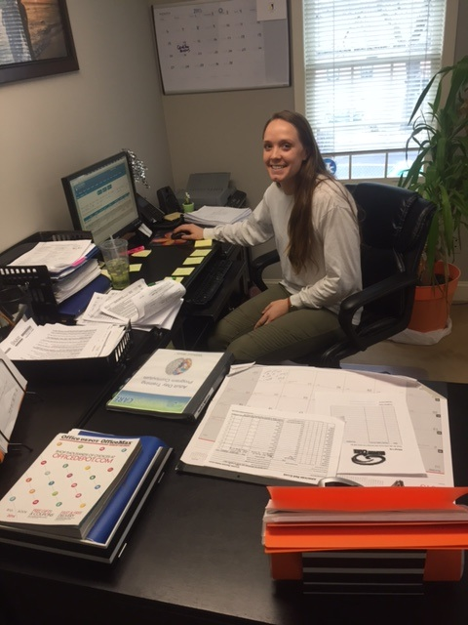
Sarah
Galvin
Communication Intern Recovery Care

Slide 12
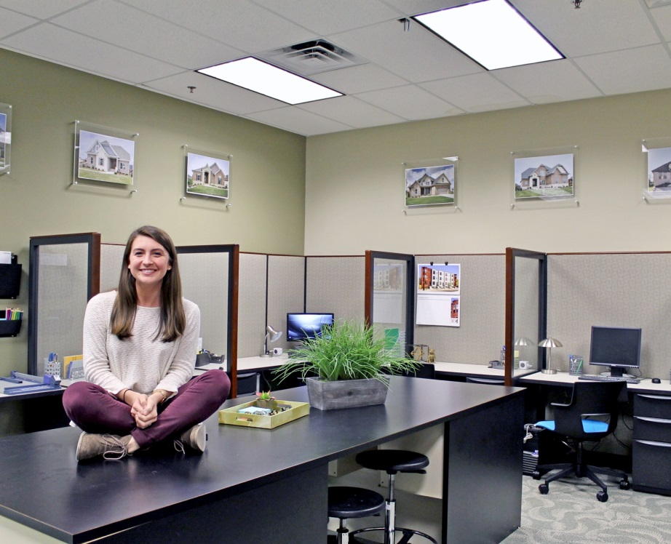
Alex Ginter
Social Media/ Marketing Intern RJ Thieneman Real Estate Co.

Slide 13
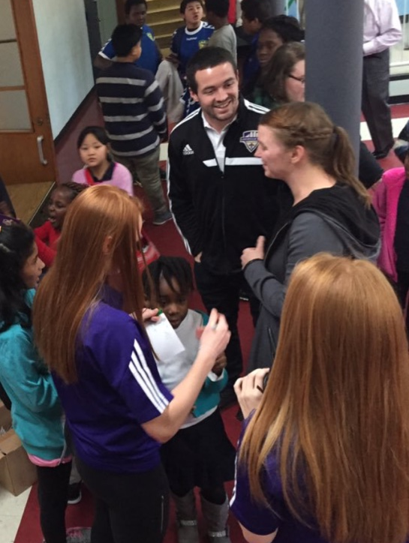
Mary Beth Gorham
Design Intern Louisville City Football Club

Slide 14
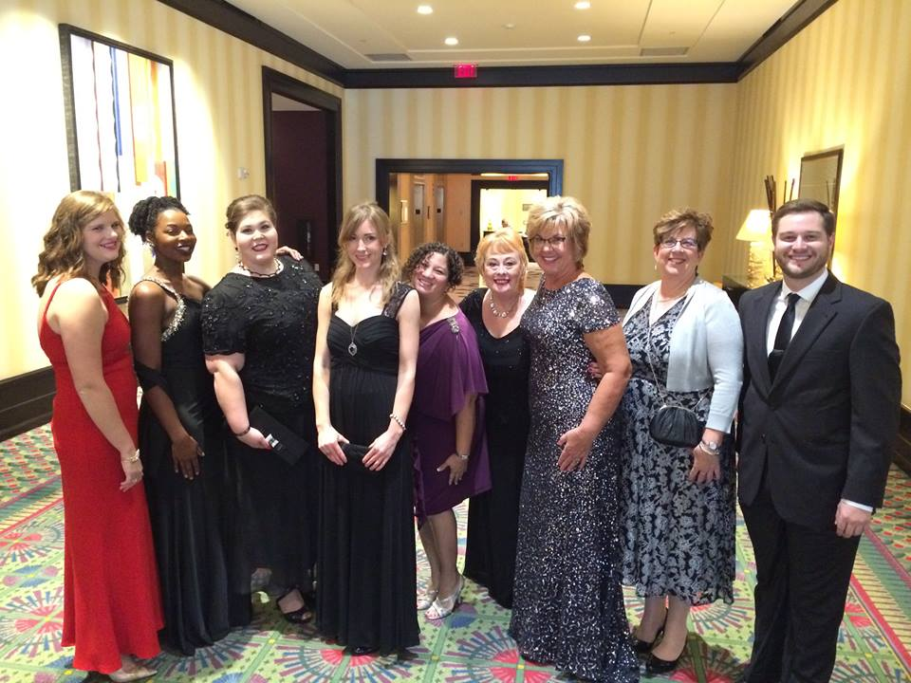
Jonna
Hogan
Development Specialist Intern KentuckyOne Health

Slide 15
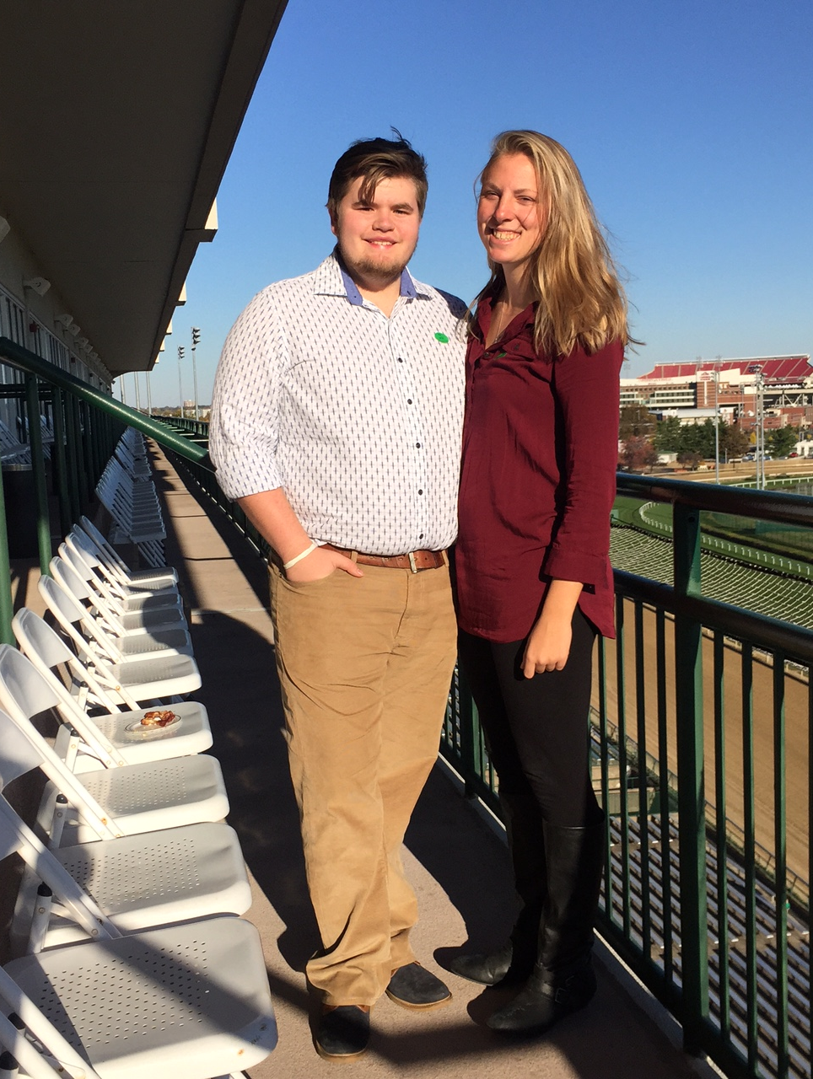
Trevor Mason
Social Media Intern Maverick Marketing & Media

Slide 16
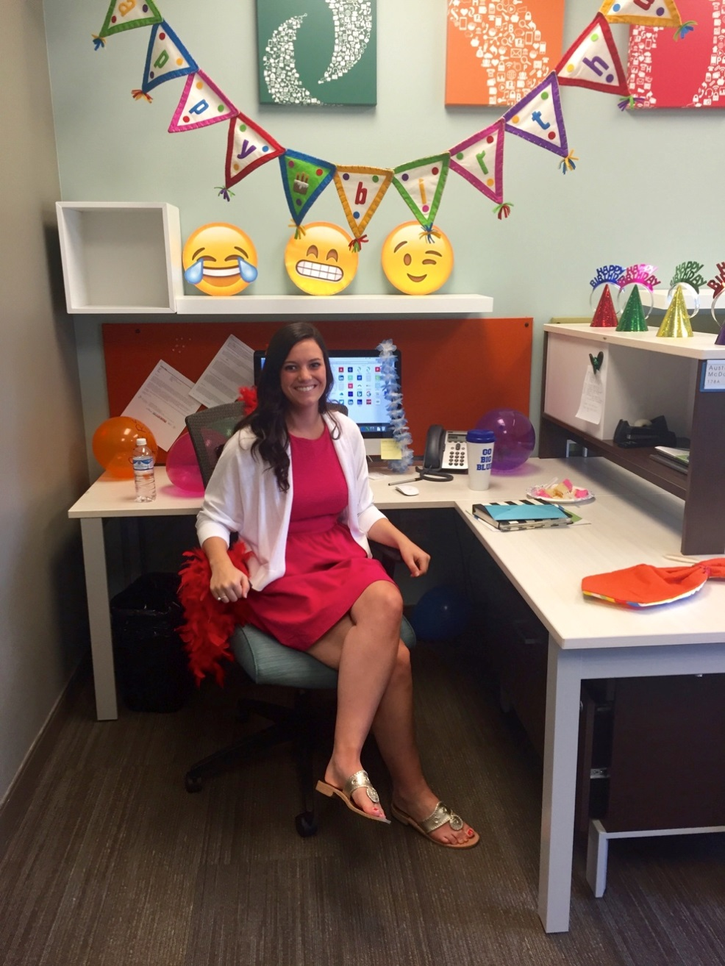
Austin McDonogh
Social Media/ Marketing Intern Park Community Credit Union

Slide 17
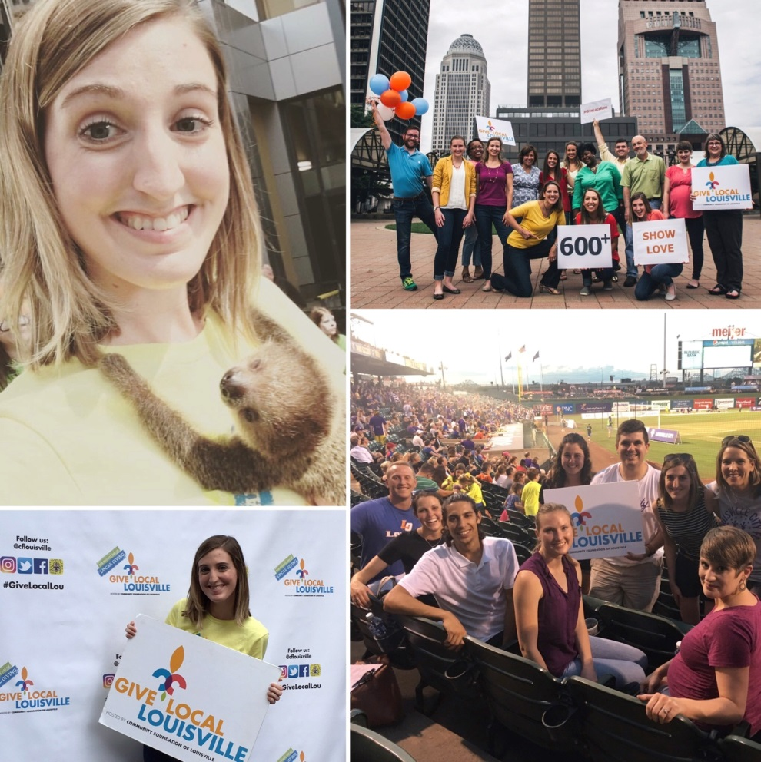
Molly Melia
Public Relations Intern Tandem Public Relations

Slide 18
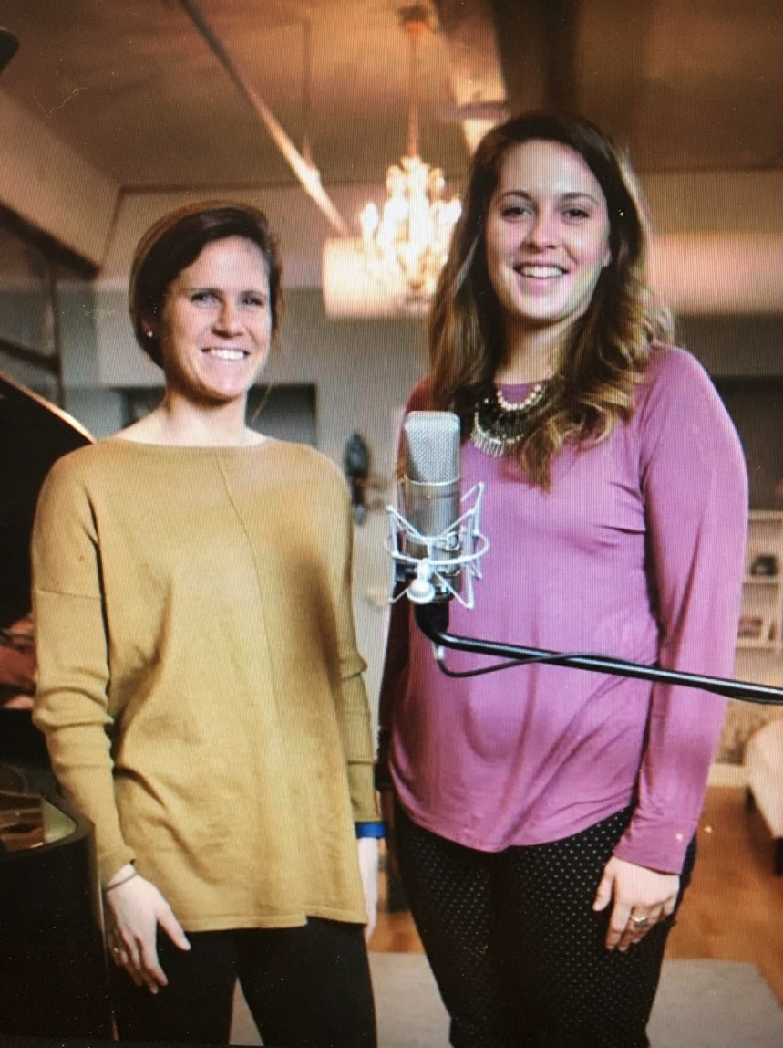
Josie
Metzger
Account Service Intern Bisig Impact Group

Slide 19
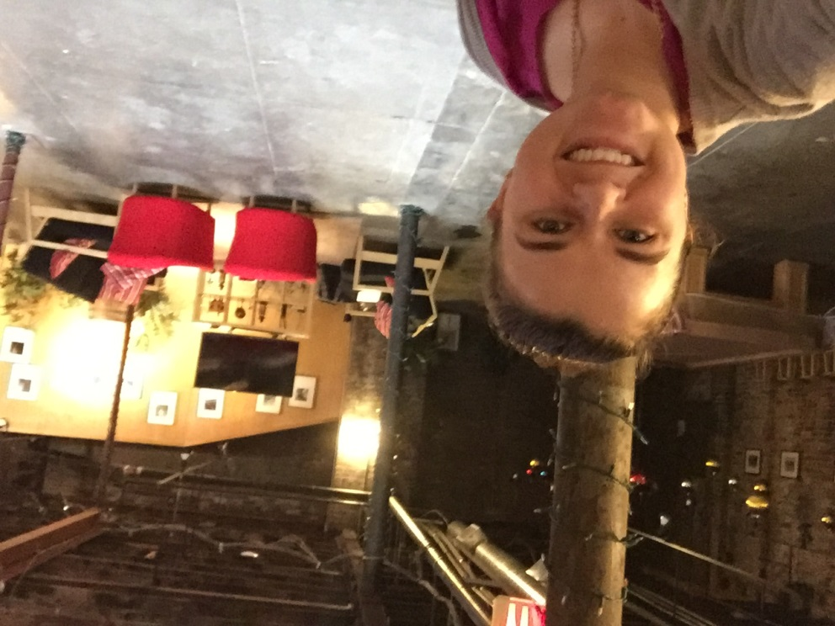
Kristen Miles
Public Relations Intern Bandy Carroll Hellige

Slide 20
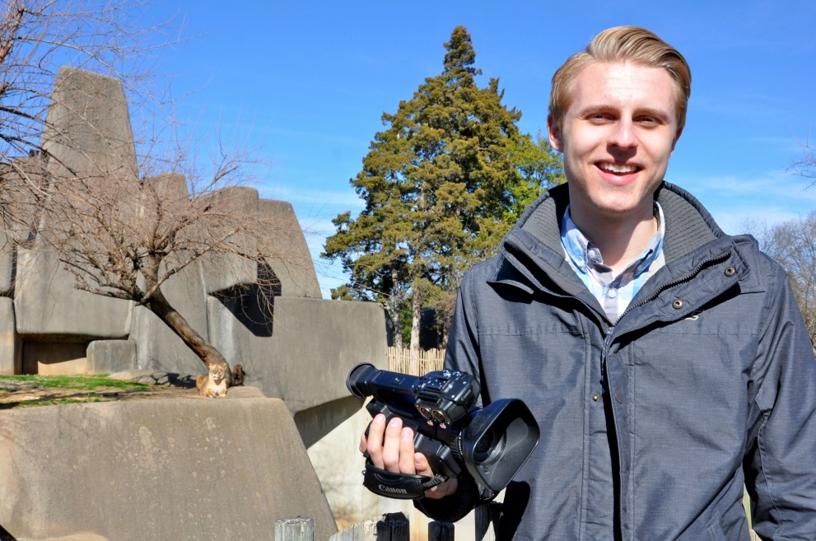
Tanner Mobley
Digital Marketing Intern Louisville Zoo

Slide 21
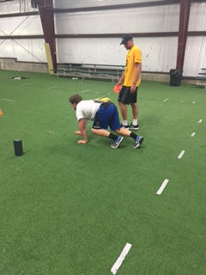
Luke Mocherman
Communication Intern Corey Taylor’s Sports Performance

Slide 22
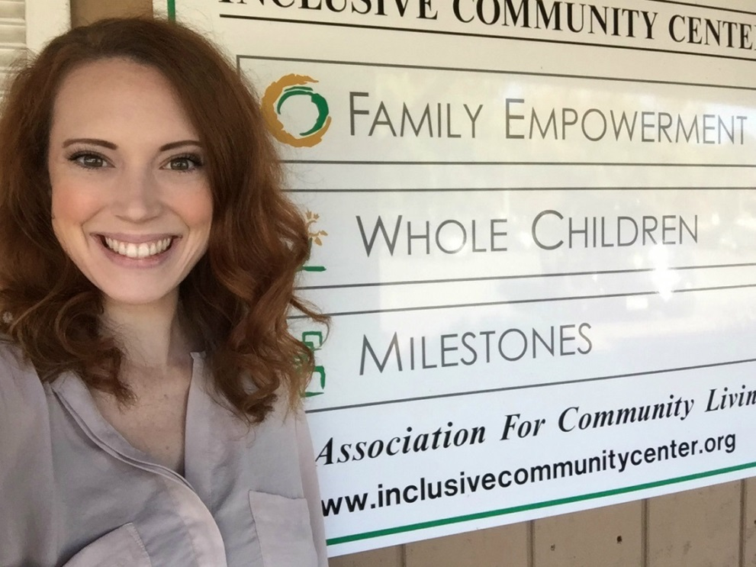
Kesley Moorefield
Radio Intern Summit Media
Communication Intern Whole Children

Slide 23
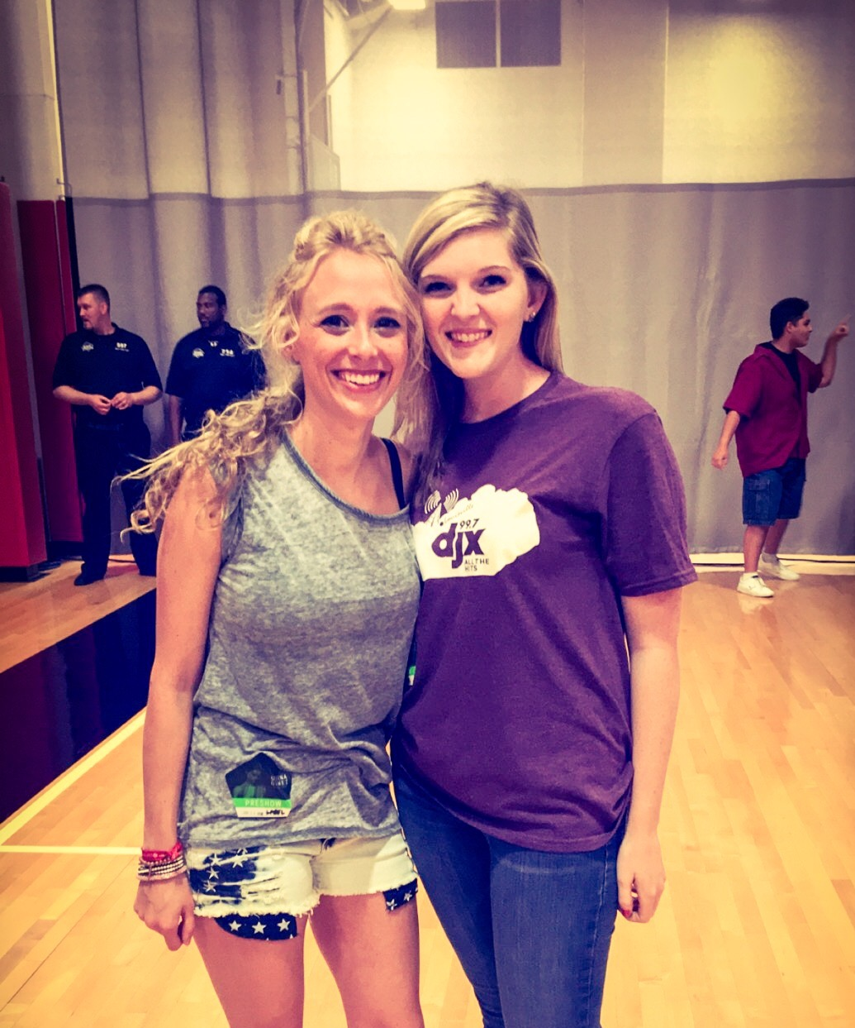
Caroline
Vance Nauert
Communication Intern
Alpha Media- WDJX 99.7

Slide 24
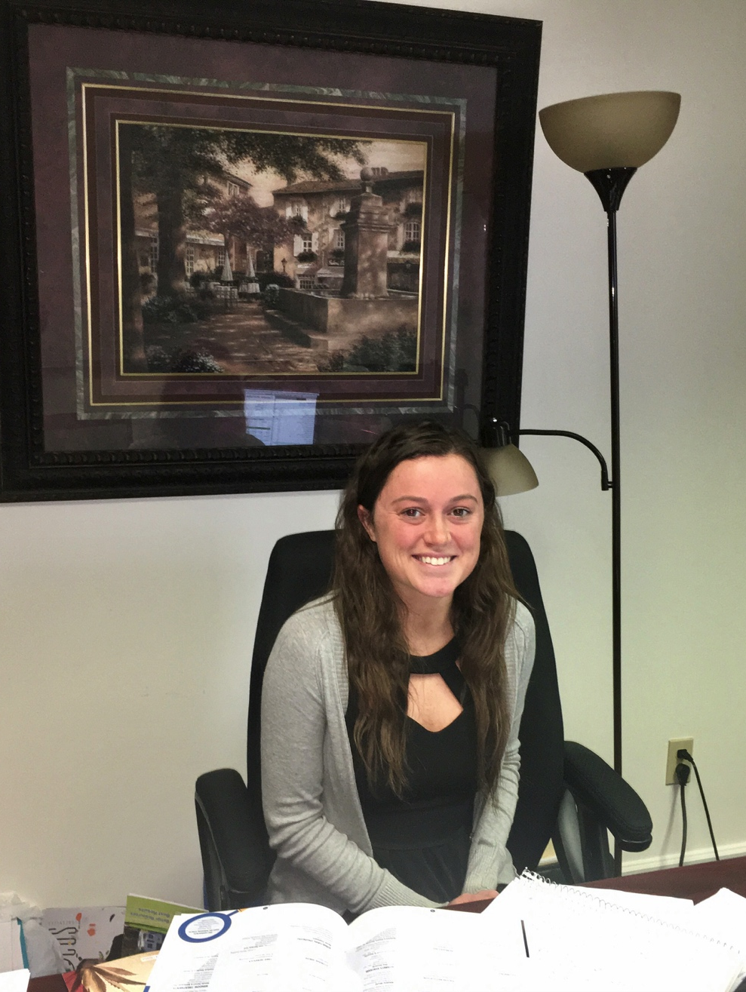
Kelsey
O’Bryan
Social Media Intern Rising Tide Marketing & Events

Slide 25
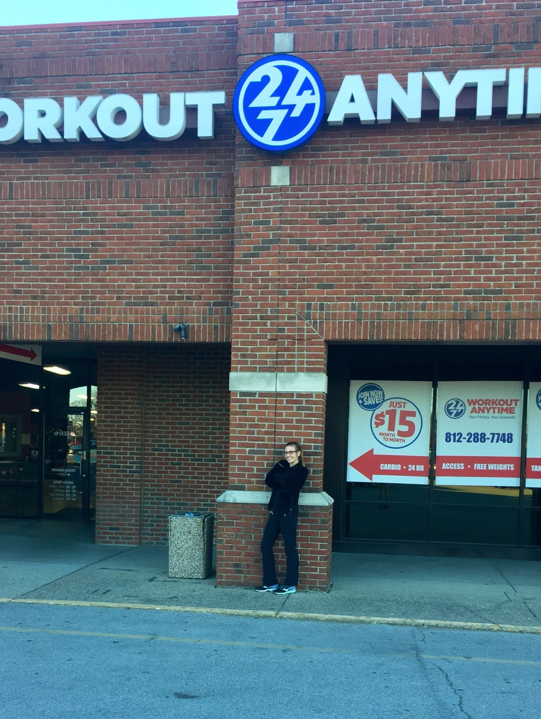
Anna
O’Toole
Marketing Intern Workout Anytime

Slide 26
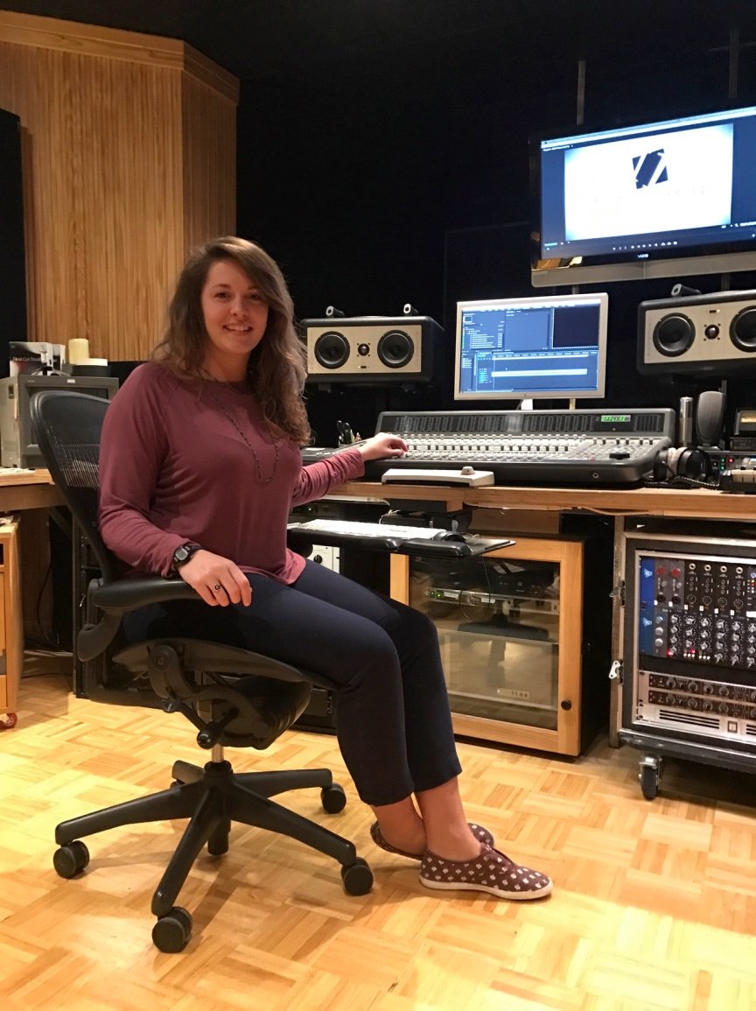
Lakin
Pack
Communication Intern Bisig Impact Group

Slide 27
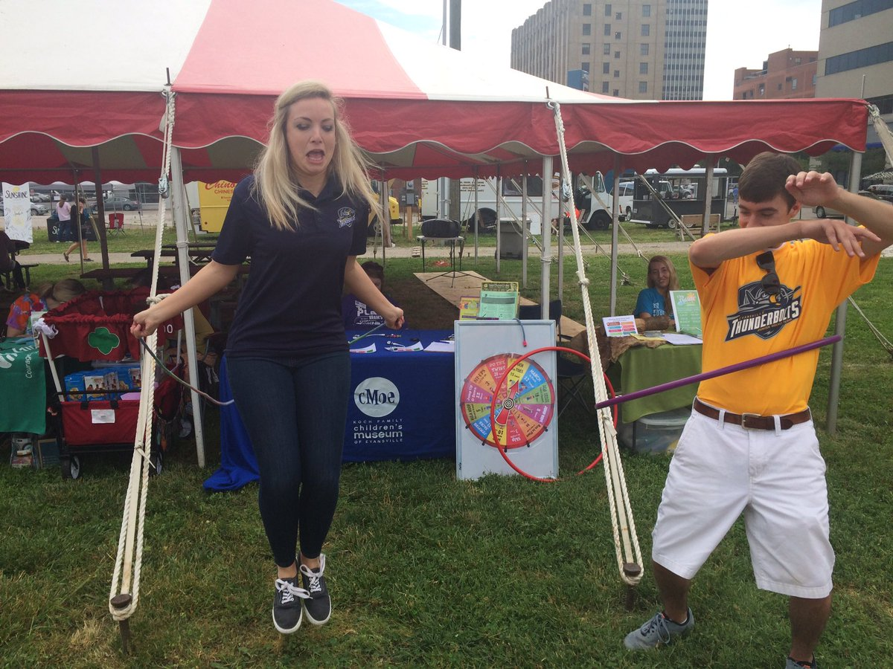
Sam
Parkison
Media Relations Intern Evansville Thunderbolts

Slide 28
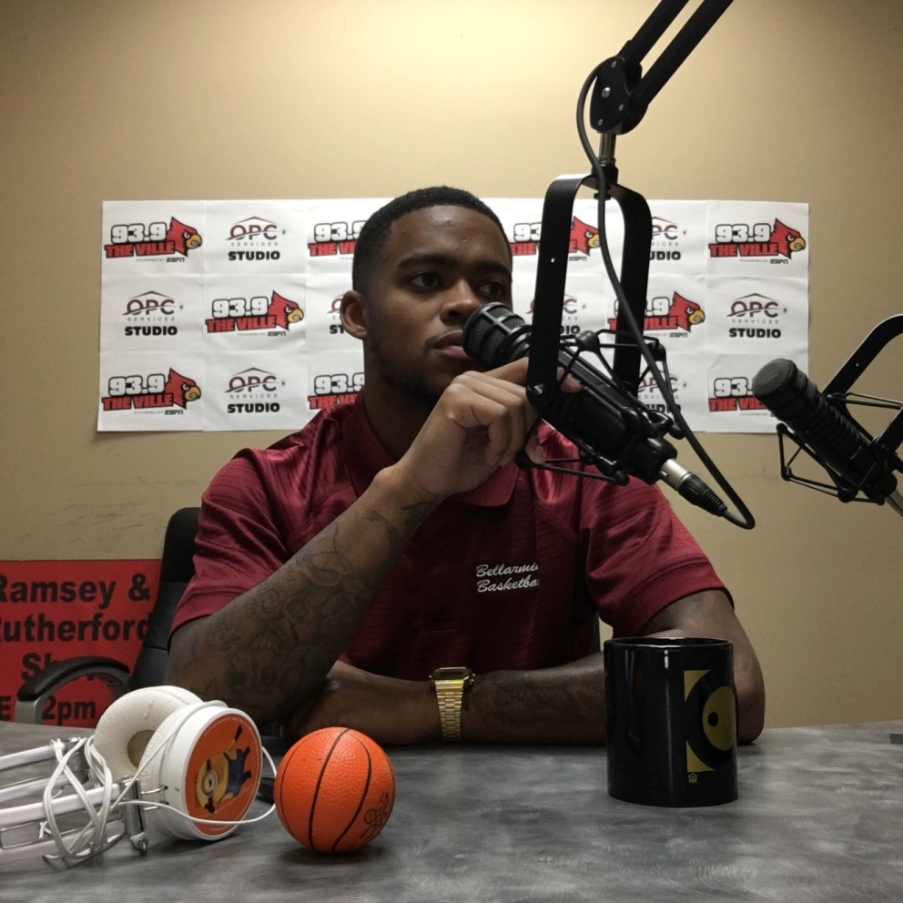
Michael
Parrish
Communication Intern ESPN 680

Slide 29
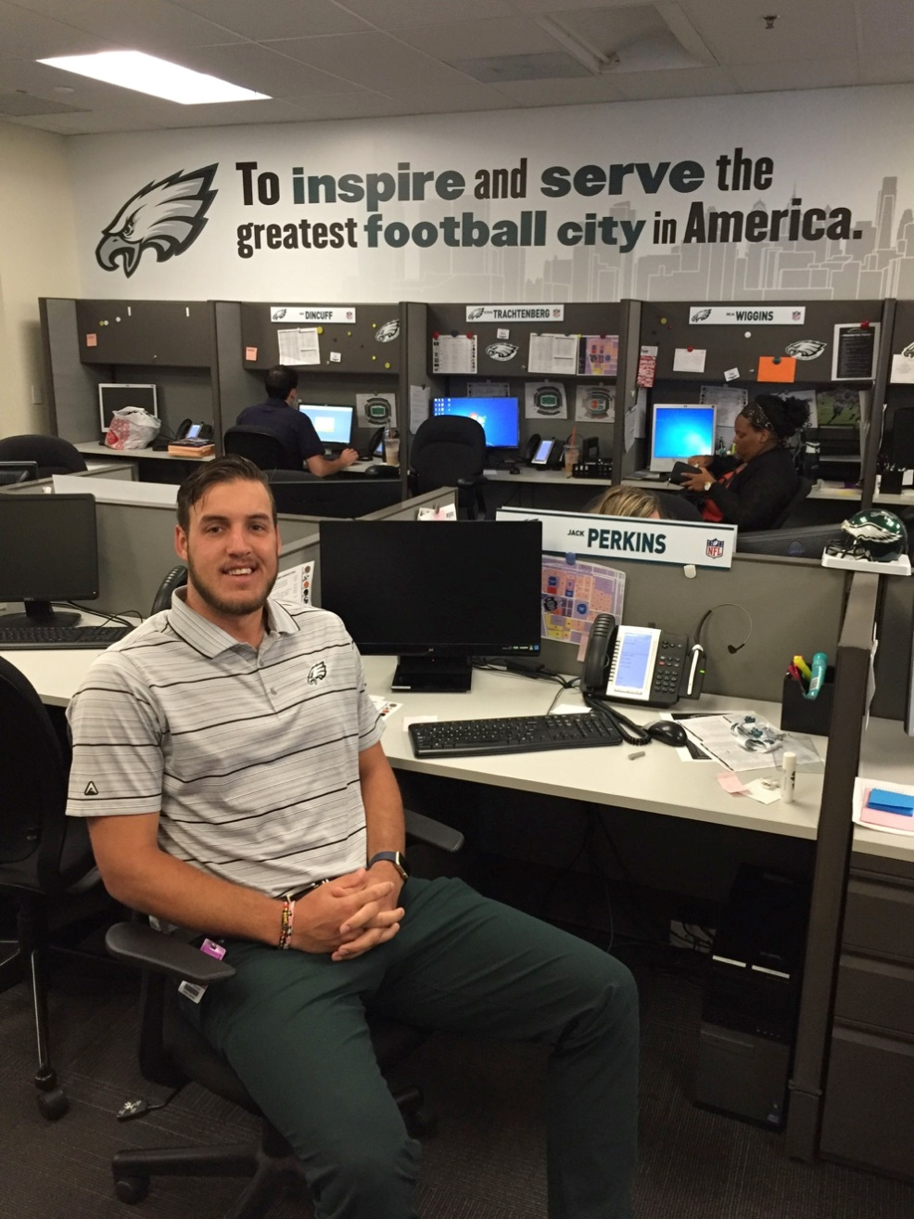
Jack
Perkins
Ticket Office & Guest Services Intern Philadelphia Eagles

Slide 30
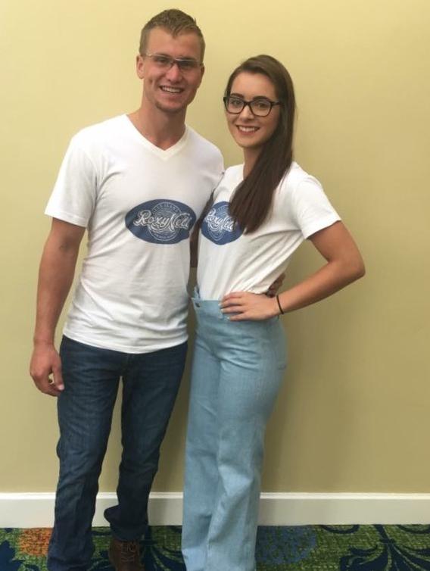
Yancey
Pritchett
Social Media Intern Roxy Nell Blue Jeans

Slide 31
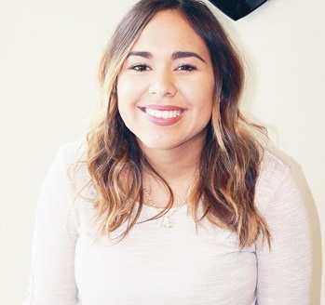
Jamilee
Rivera
Social Media/ Marketing Intern RJ Thieneman Realty Group

Slide 32
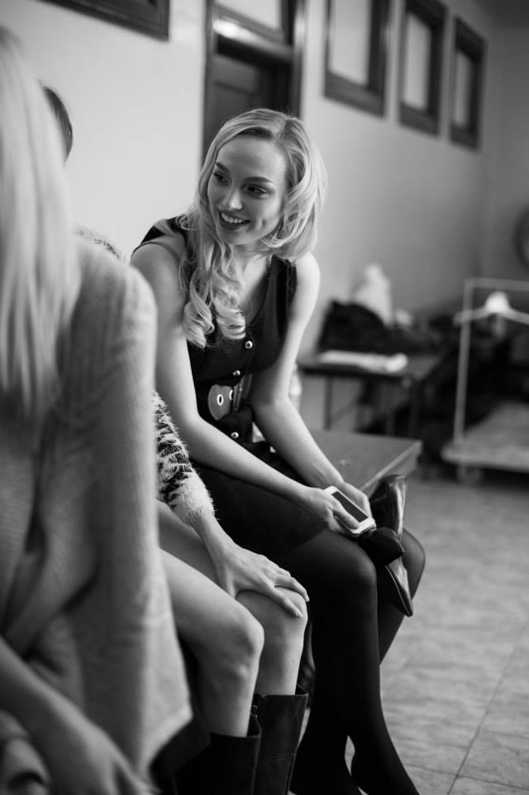
Olivia
Ross
Social Media Intern Mother Model Management
Public Policy Intern Greater Louisville Inc.

Slide 33
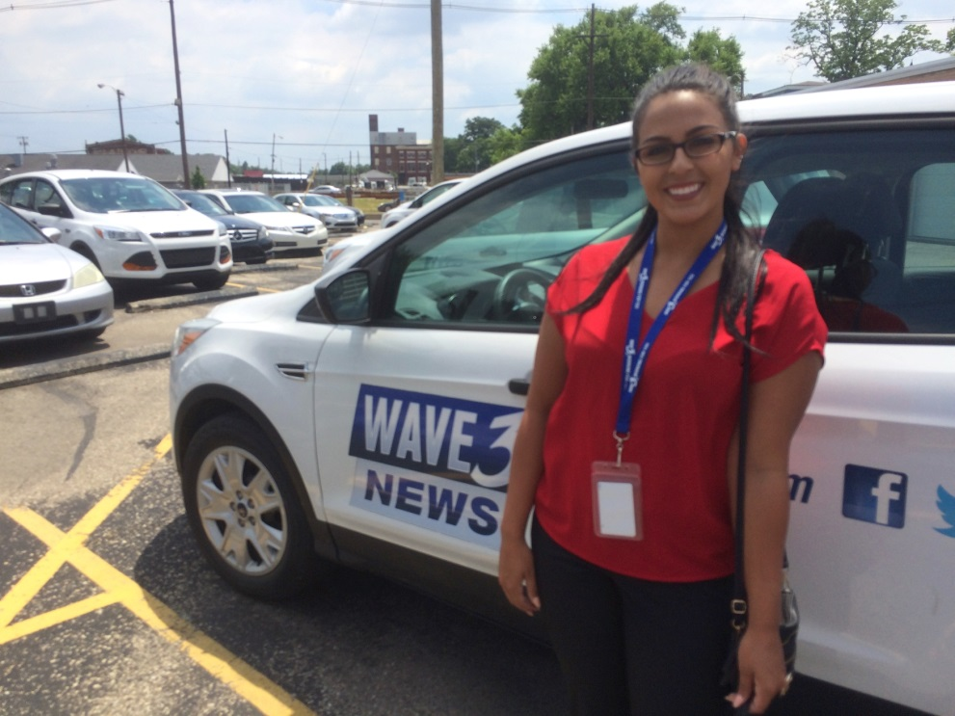
Olivia
Russell
News Intern WAVE 3 News

Slide 34
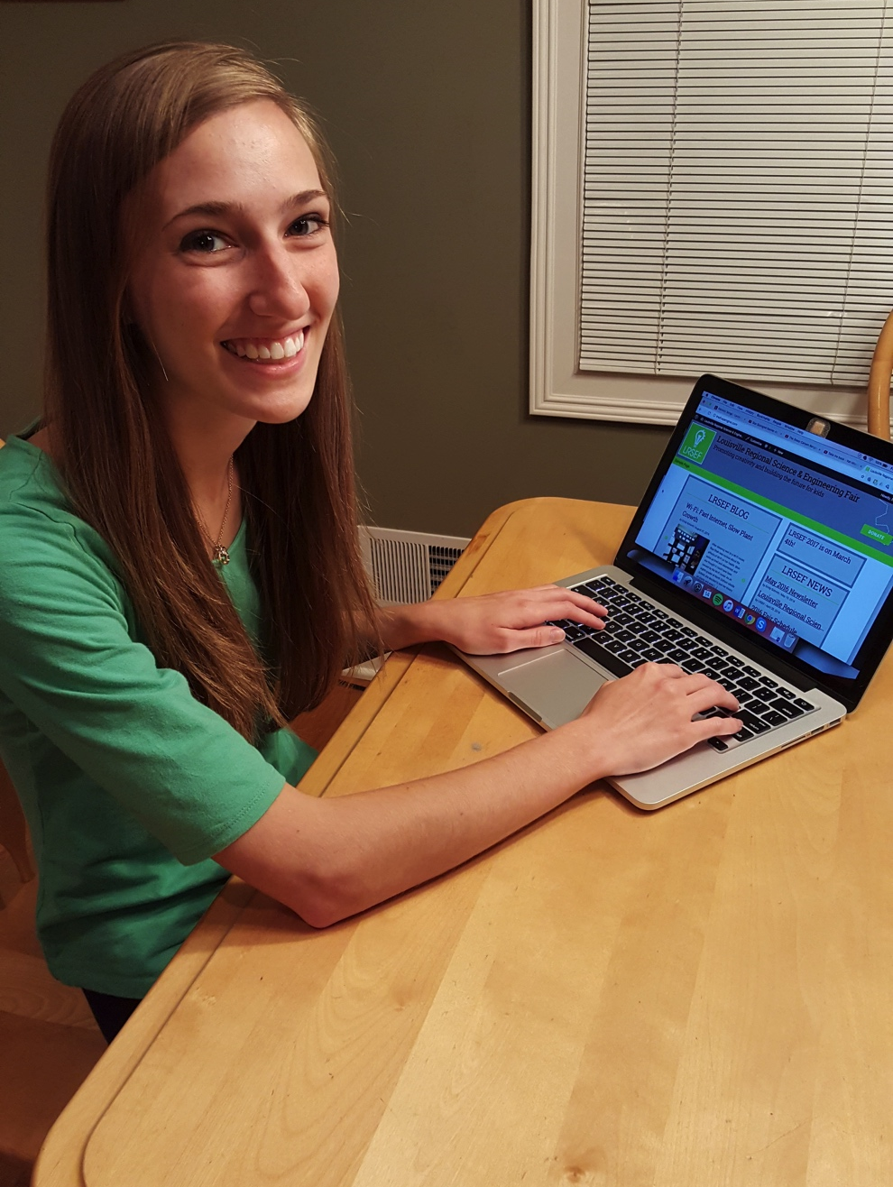
Emily
Schmitt
Marketing Intern Louisville Regional Science & Engineering Fair

Slide 35
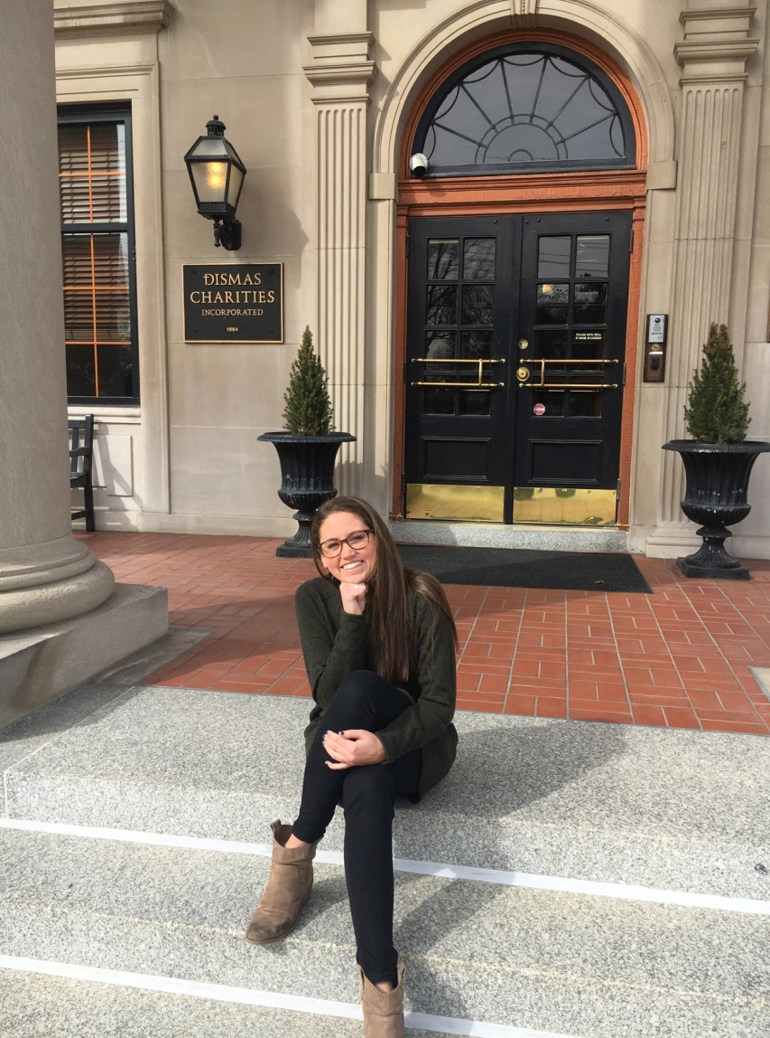
Kathryn Schneidtmiller
Social Media Intern Dismas Charities, Inc.

Slide 36

Alena Schuckmann
Photography Intern Louisville City Football Club

Slide 37
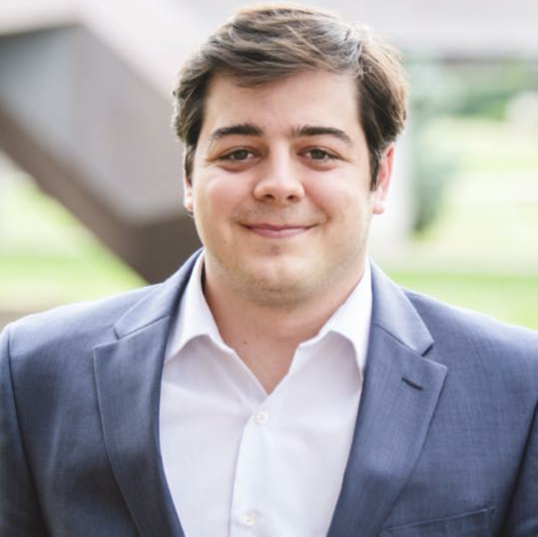
Jacob
Schuhmann
Communication Intern Strive

Slide 38
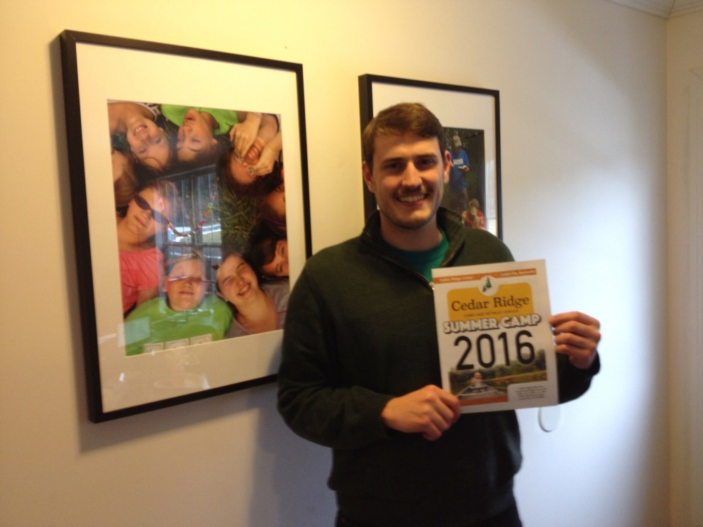
Chris
Spach
Communication Intern Cedar Ridge Camp, Inc.

Slide 39
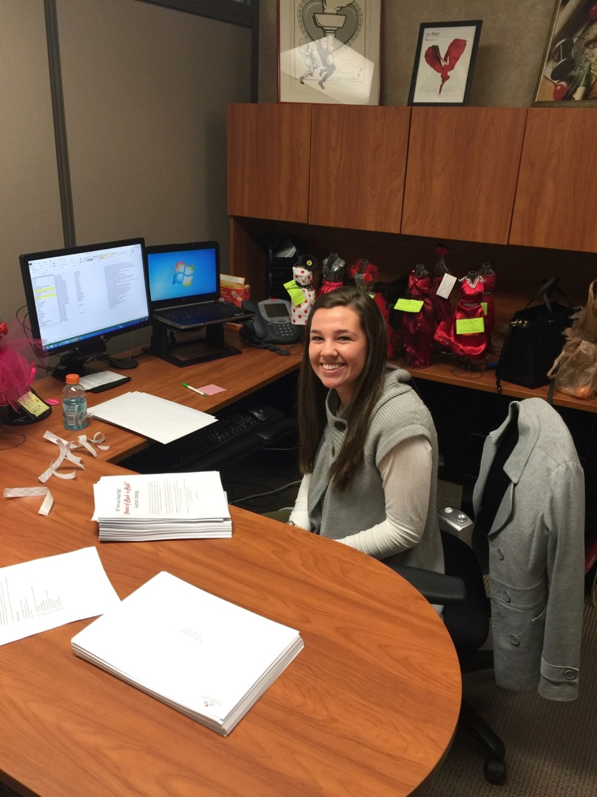
Hannah
Stemler
Communication Intern American Heart Association

Slide 40
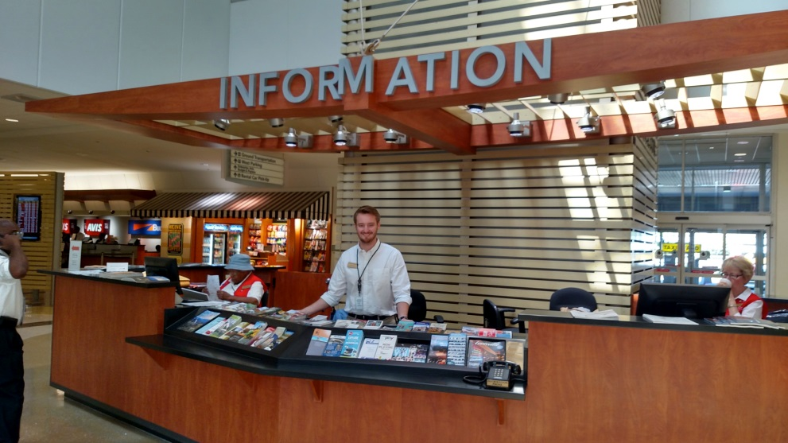
Philip
Truman
Public Relations Intern Louisville Regional Airport Authority

Slide 41
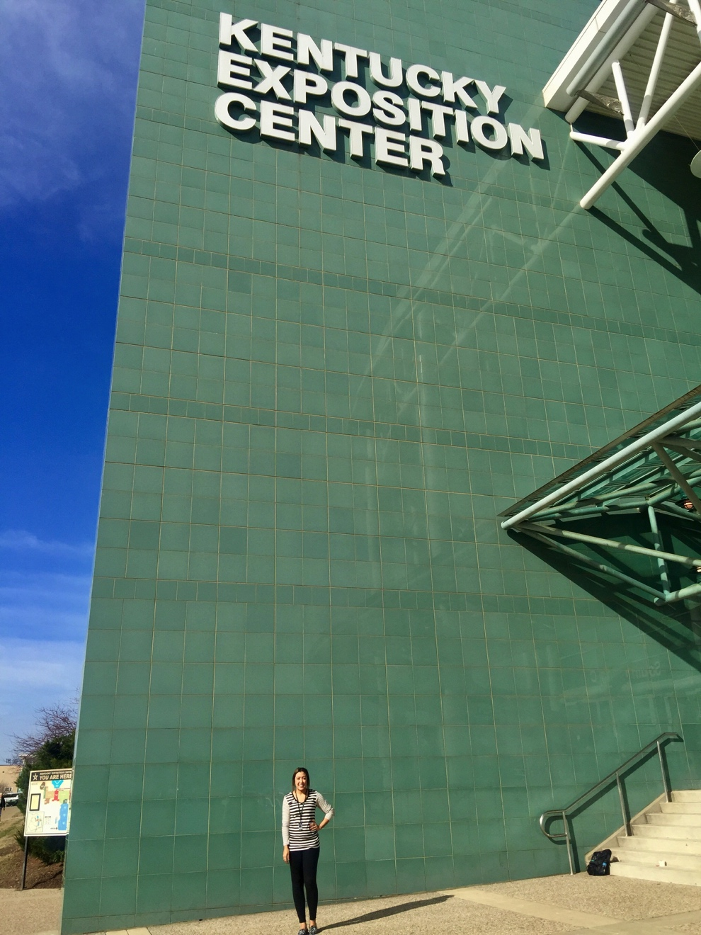
Brooke Valentine Thomas
Communication Intern Kentucky State Fair Board

Slide 42
Jerrick
Valentine
Communication Intern Get Out Network

Slide 43
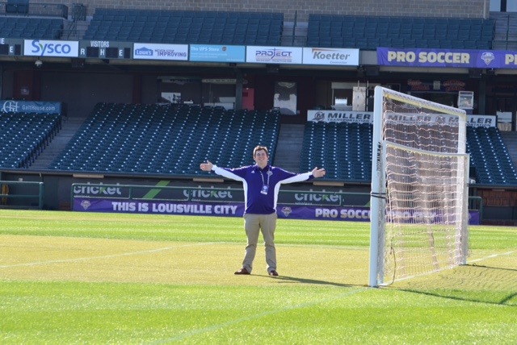
Quin
Welch
News Intern WAVE 3 News
Editorial Intern Louisville City Football Club

Slide 44
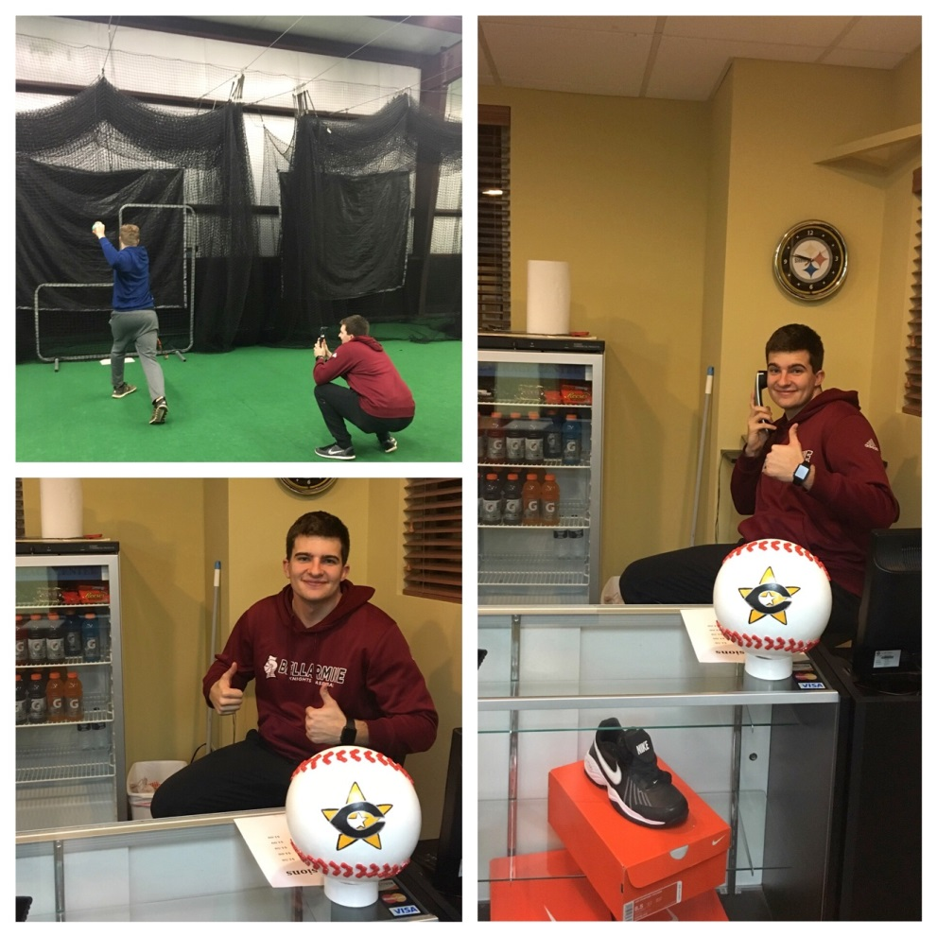
Zach
Williams
Social Media Intern Cincinnati Baseball & Sports Academy

Slide 45
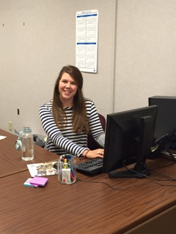
Jess
Winters
Sales & Marketing Intern GE Appliances
Communication Intern Kentucky Science Center

